Slide 1
SHOULDER PROBLEMS
Dr. Terry Hammond
Shoulder Surgeon
The Shoulder and Sports Medicine Centre, Pindara Place
Gold Coast Hospital

Slide 2
Clavicle Fractures – Mid-shaft
“Rule of one inch (2.5cm)”
Treat with watchful neglect

Slide 3
Clavicle Fractures - Midshaft
“Rule of one inch (2.5cm)”
Less than one inch shortened or vertically
displaced- non-operative treatment
More than one inch – plate
Don’t worry about comminuted fractures if
less than 2.5 cm displaced

Slide 4
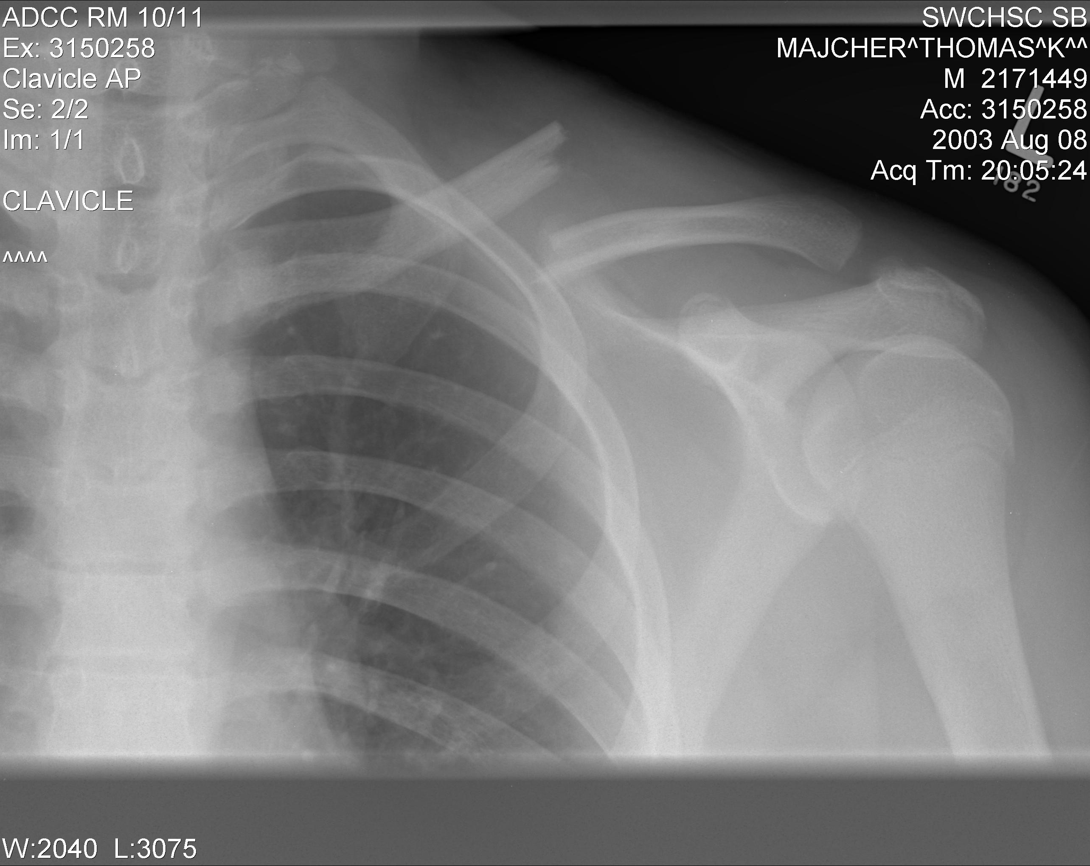

Slide 5
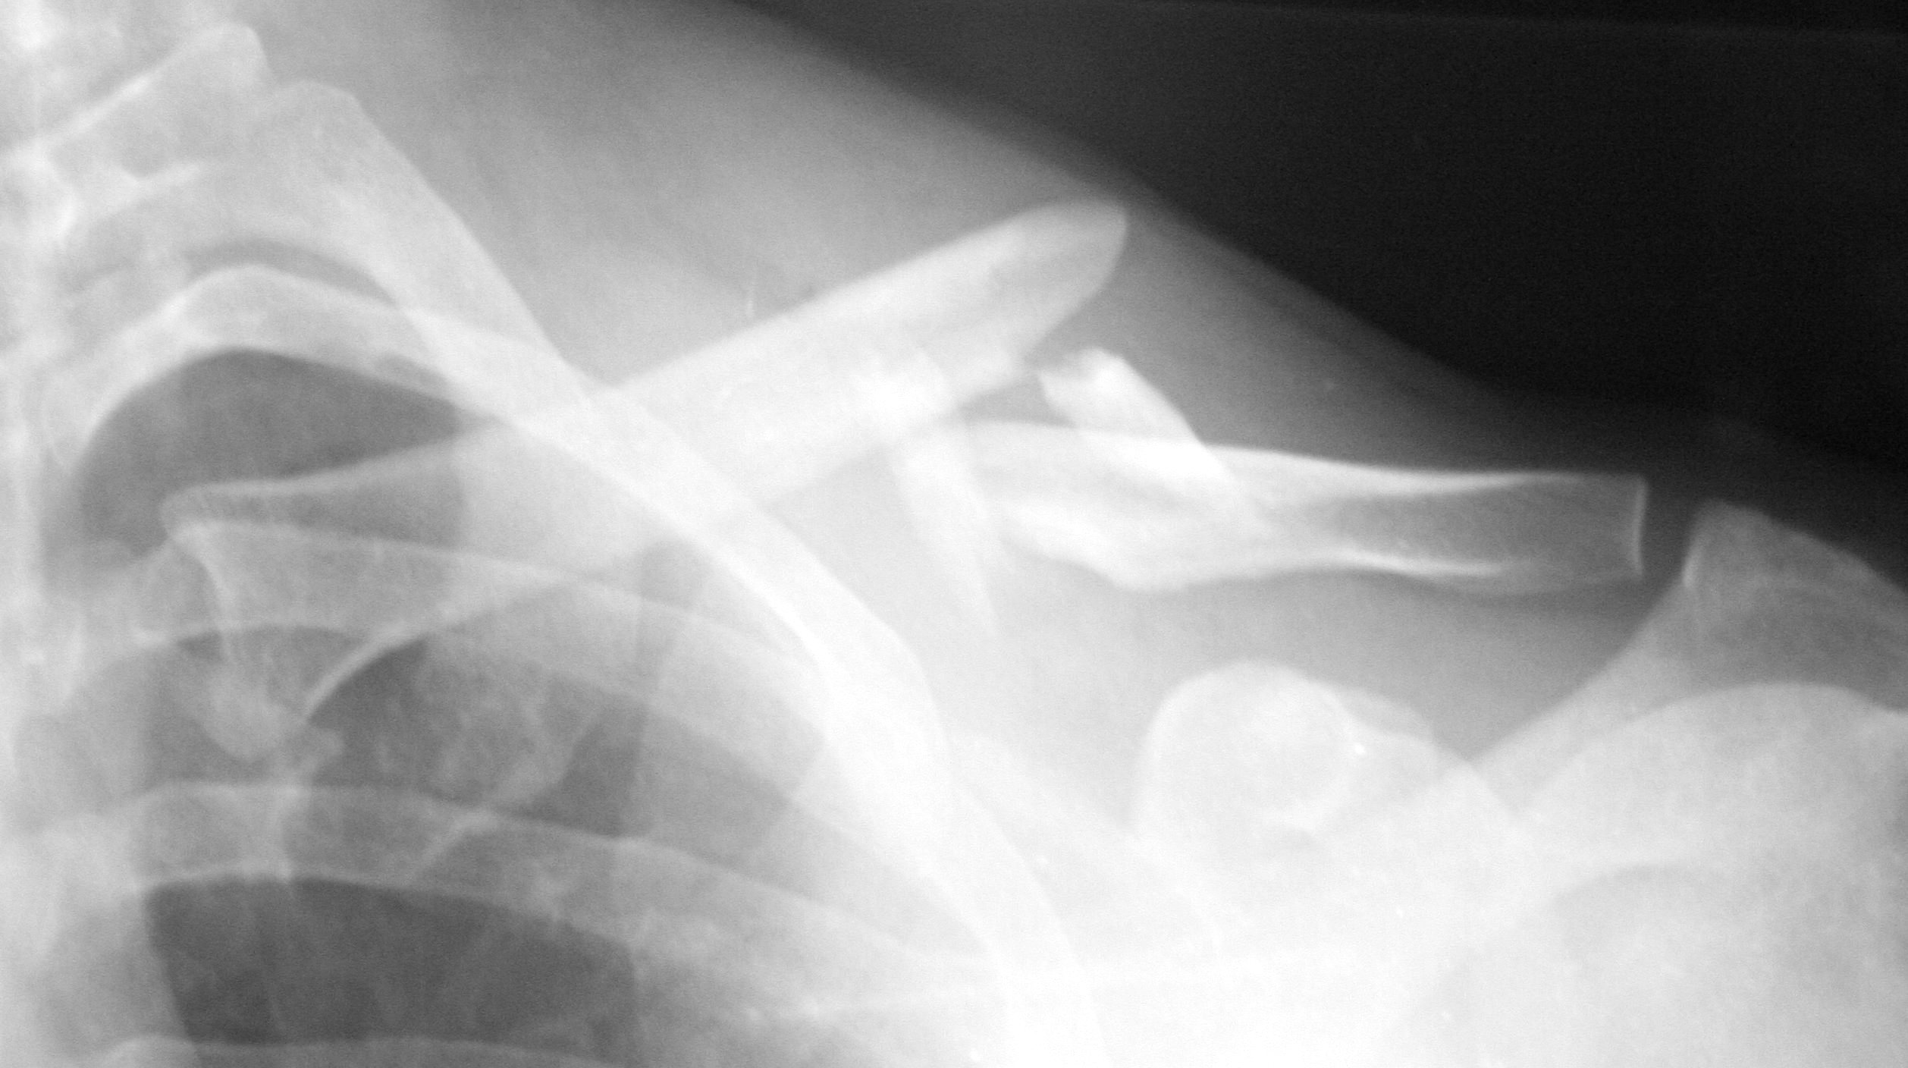

Slide 6
Clavicle Fractures – Watchful neglect
Sling for comfort, allow out of sling anytime and abandon when comfortable (often about 3 weeks)
Figure 8 sling not needed
Don’t worry about tenting skin – rarely gives a problem

Slide 7
Clavicle Fractures – Watchful Neglect
Review on clinical grounds – less crepitus, less pain and return of function.
X-ray only if necessary – non-unions only established after 16 weeks

Slide 8
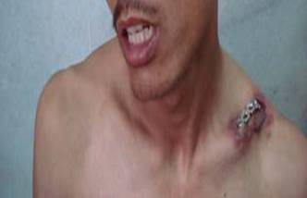

Slide 9
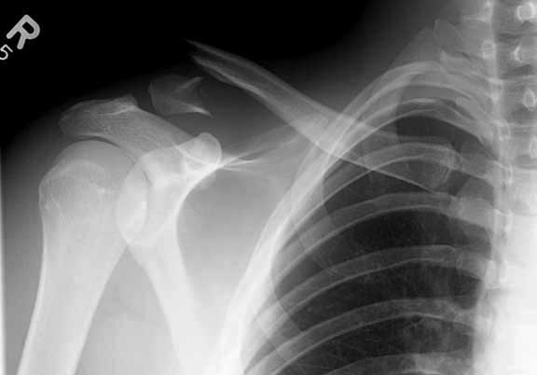
Clavicle Fractures – Distal third

Slide 10
Clavicle Fractures – Distal third
Refer all
My treatment will be-
Undisplaced (rare) – non-operative treatment
Displaced – surgery due to high non-union rate

Slide 11
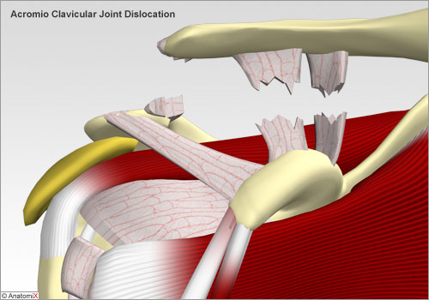
Acromio-clavicular Joint Dislocations

Slide 12
Acromio-clavicular Joint Dislocations
Clinical
Direct blow on point of shoulder – fall or sport
Tenderness and pain over ACJ
Often misdiagnosed as shoulder dislocation
Treatment
Refer if bottom of clavicle is above top of acromion (grade 3 or more)
If not treat as for clavicle fracture with sling for comfort
Will be sore for as long as a year!

Slide 13
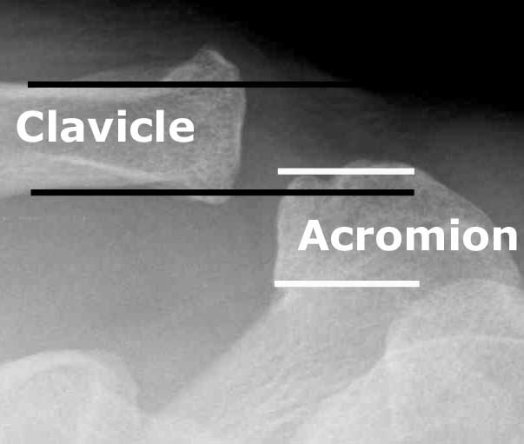

Slide 14
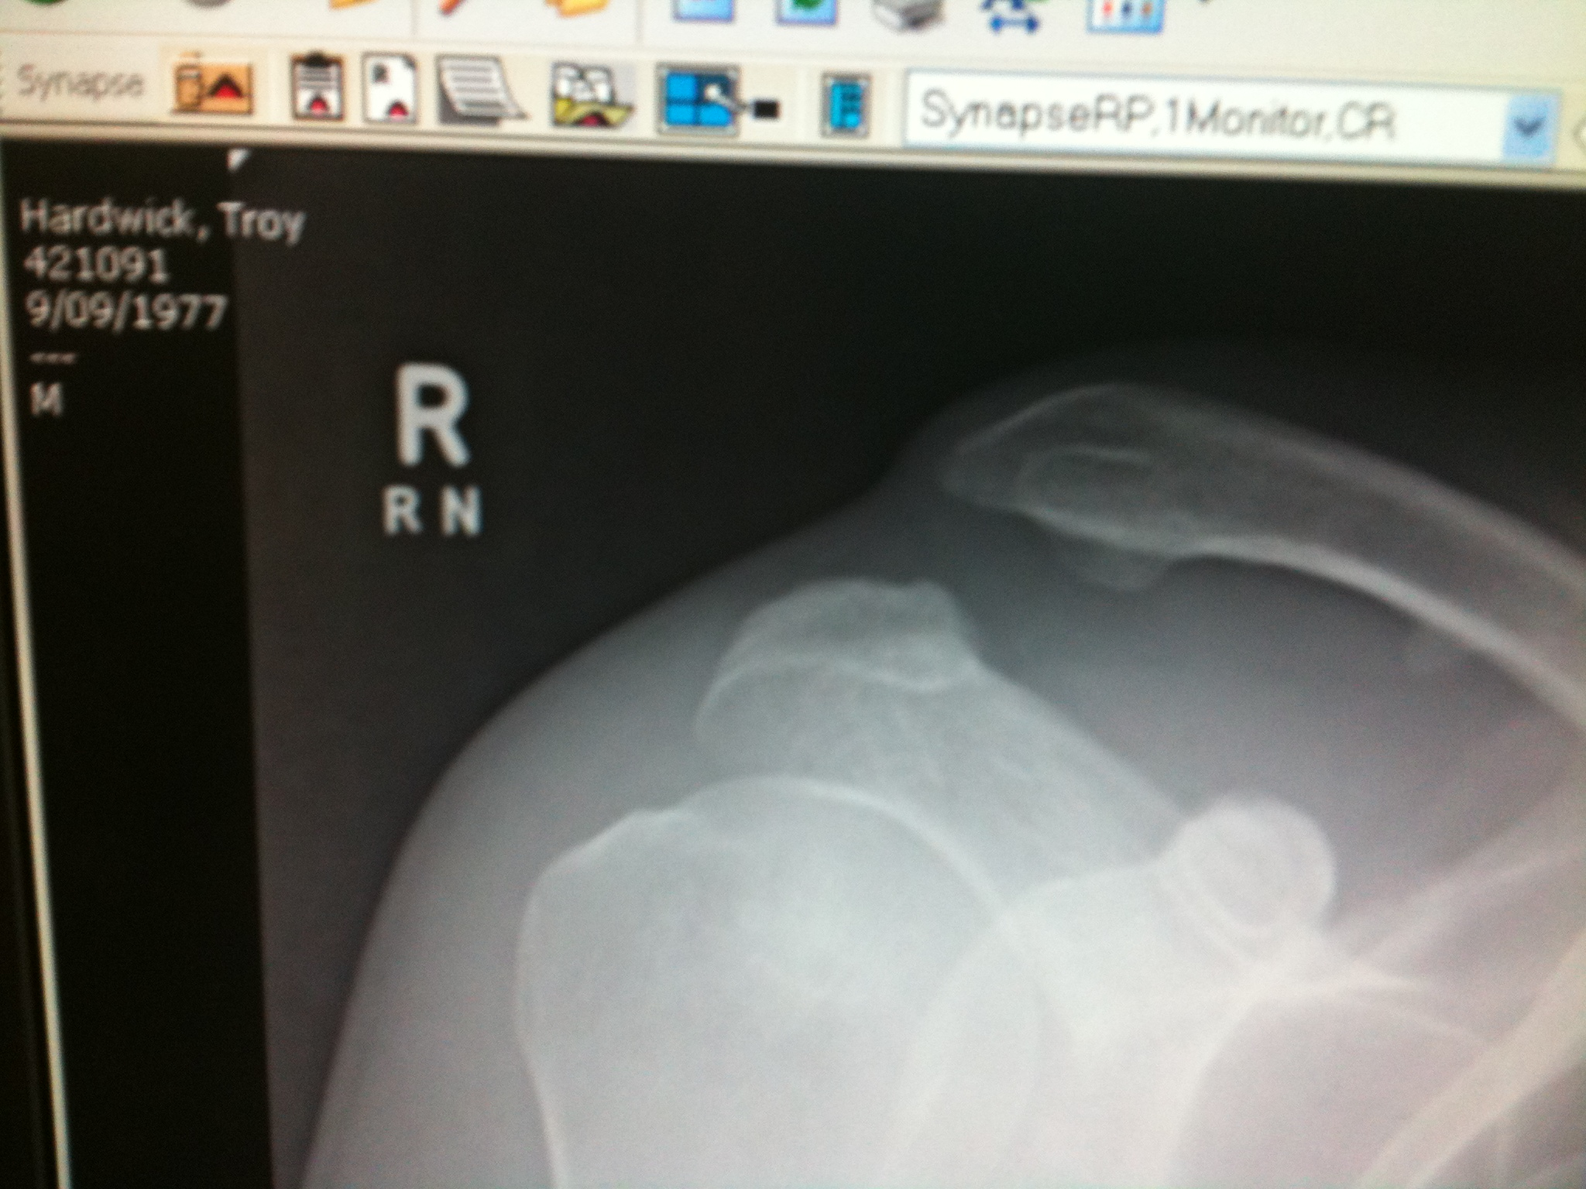

Slide 15
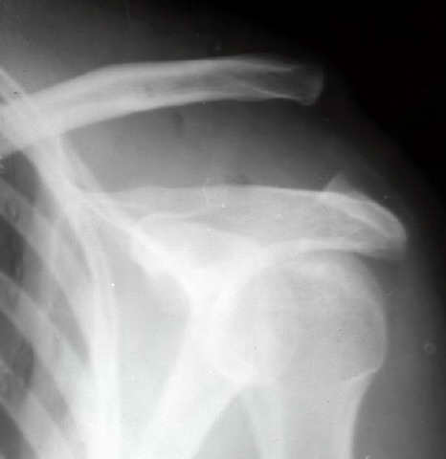

Slide 16
Proximal Humerus Fractures
Ensure AP and lateral xrays
Refer if any displacement!
Collar and cuff for 4 – 6 weeks if non-operative treatment planned
Needs regular xrays

Slide 17
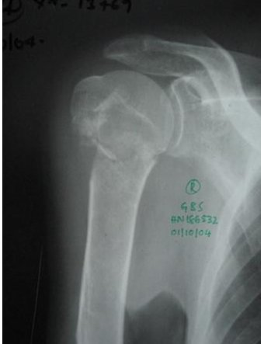

Slide 18
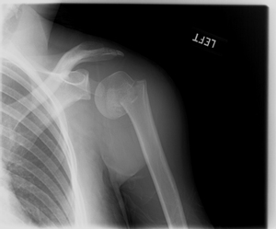

Slide 19
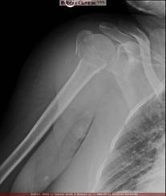

Slide 20
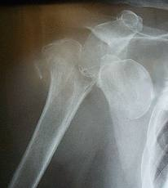

Slide 21
Proximal Humerus Fractures
Watch greater tuberosity fractures!
Go posteriorly, are hard to see on x-rays and cause impingement long term
May also indicate a dislocation with an acute rotator cuff tear which needs urgent surgery!

Slide 22
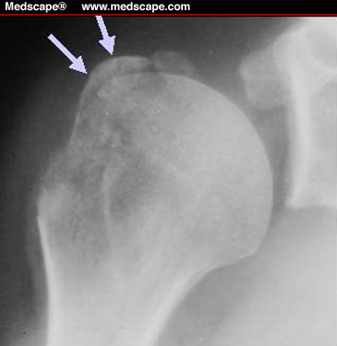

Slide 23
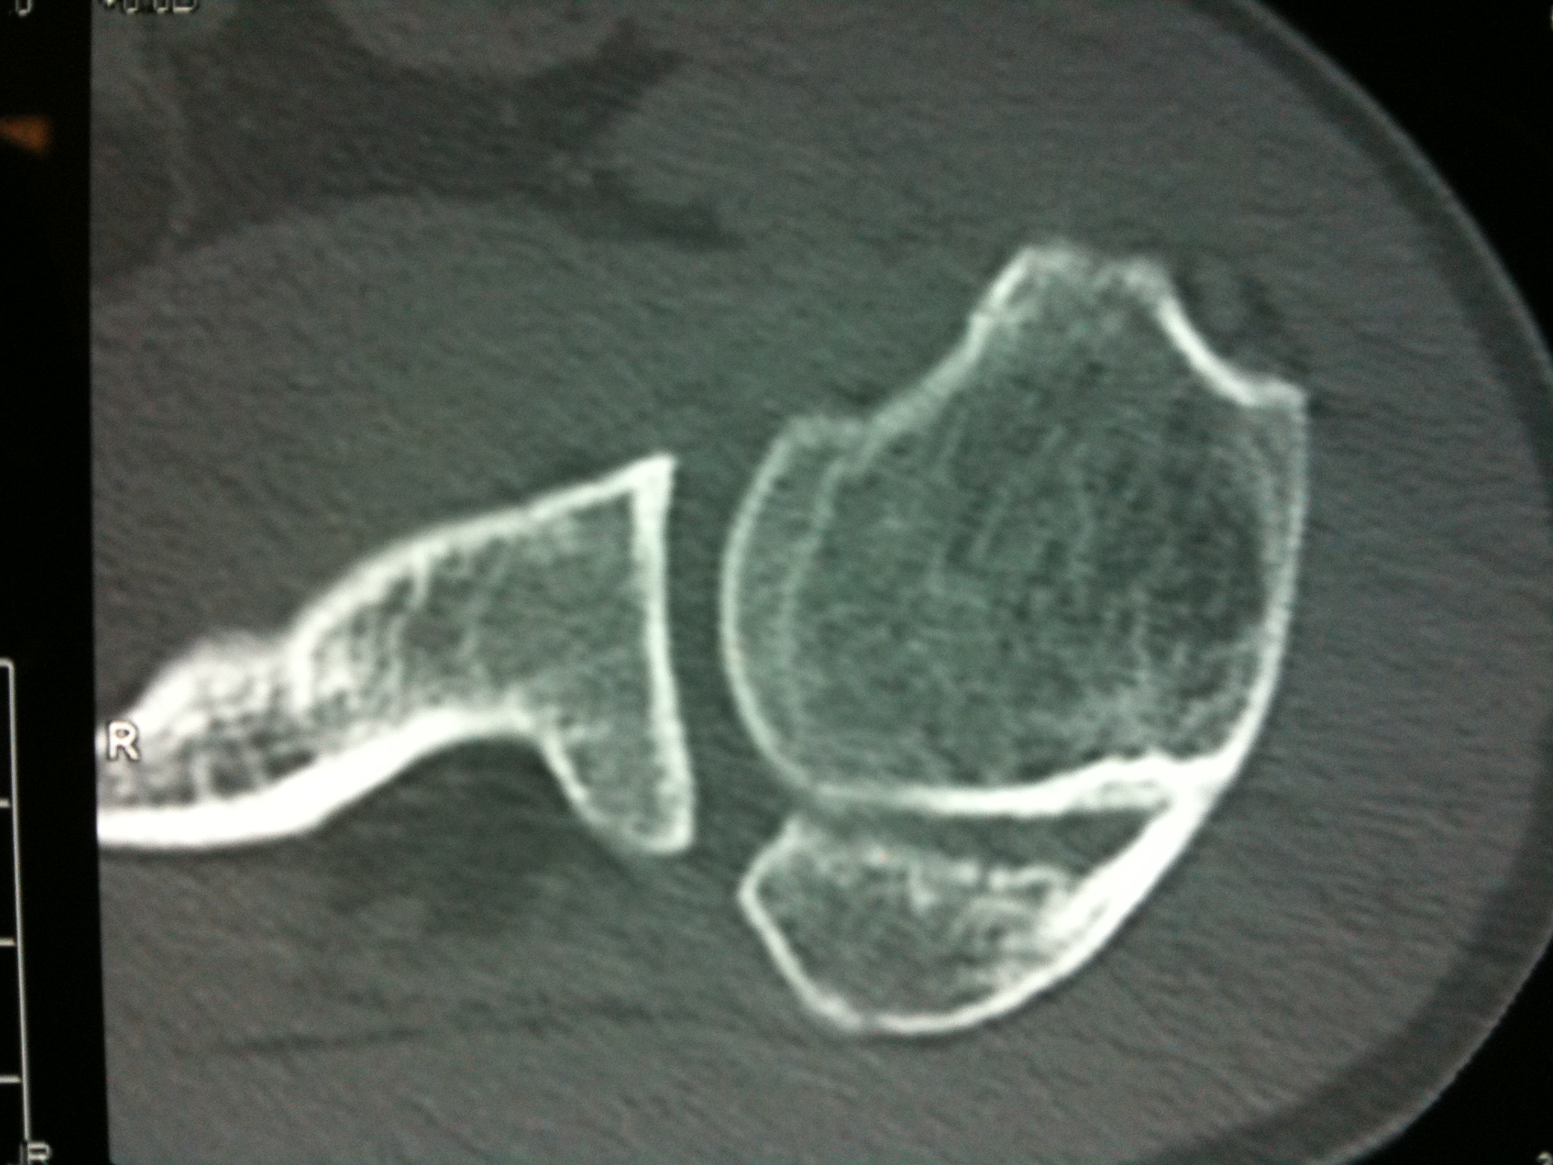

Slide 24
Midshaft Humerus fractures
Most treated non-operatively
Try Don Joy Humeral Stabilization System Brace
Radial nerve palsy
Observe unless occurs some time after injury – may be caught in fracture ends

Slide 25
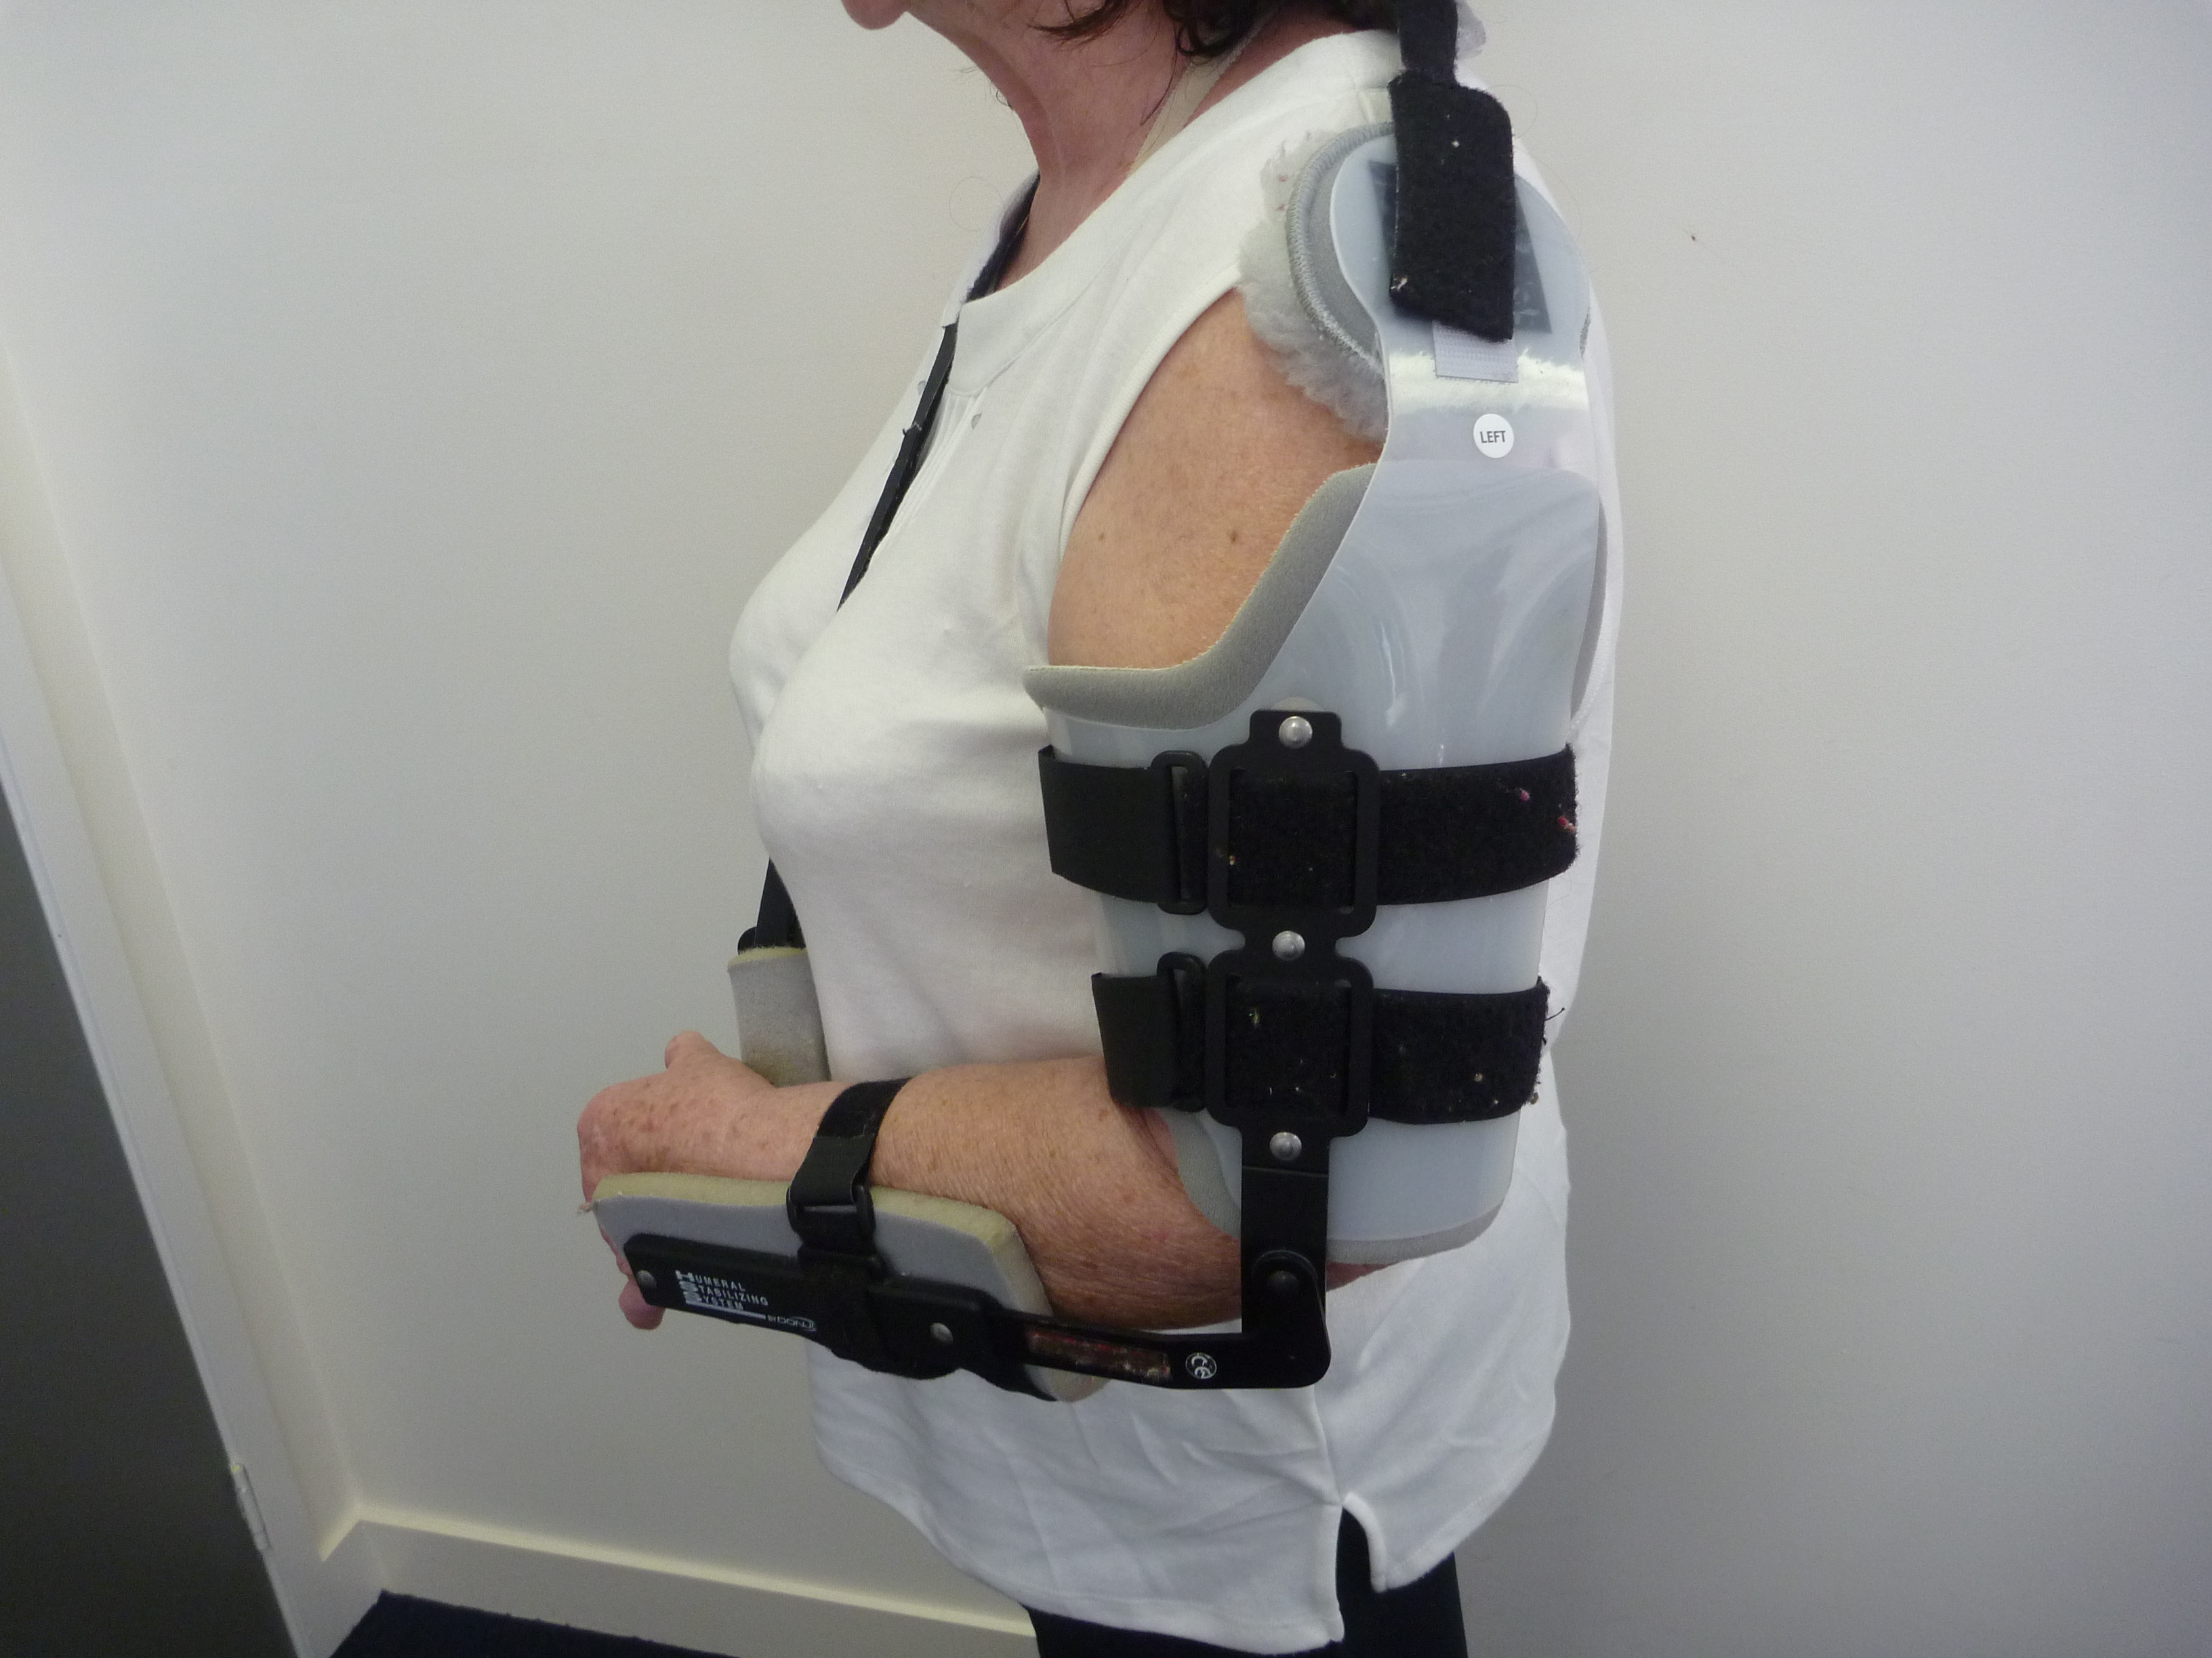

Slide 26
FROZEN SHOULDER
= ADHESIVE CAPSULITIS
Capsule gets stiff and painful

Slide 27
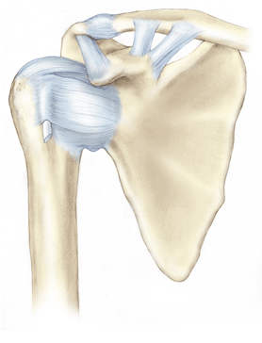

Slide 28
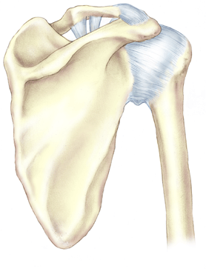

Slide 29
FROZEN SHOULDER
Pain and stiffness (loss of passive
movement)
Unknown cause
-1/2 spontaneous
-1/2 (very) minor trauma

Slide 30
FROZEN SHOULDER
***Diabetic***
40-60 yr old female
Often no previous problems
Miserable

Slide 31
FROZEN SHOULDER
Very common – I see 250 new cases every year
Most misdiagnosed!

Slide 32
FROZEN SHOULDER
Pain
Aching, night-time, severe
Felt in upper arm as well as shoulder
Severe with sudden movements
‘drops me to my knees’!
Often don’t notice stiffness – if they do
‘can’t do bra, put on deodorant’

Slide 33
FROZEN SHOULDER
Pain only– 1-2/12
Pain and stiffness – 6/12
Stiffness only – 12/12
Resolution – 2 years

Slide 34
FROZEN SHOULDER
Hallmark is decreased
passive external rotation

Slide 35
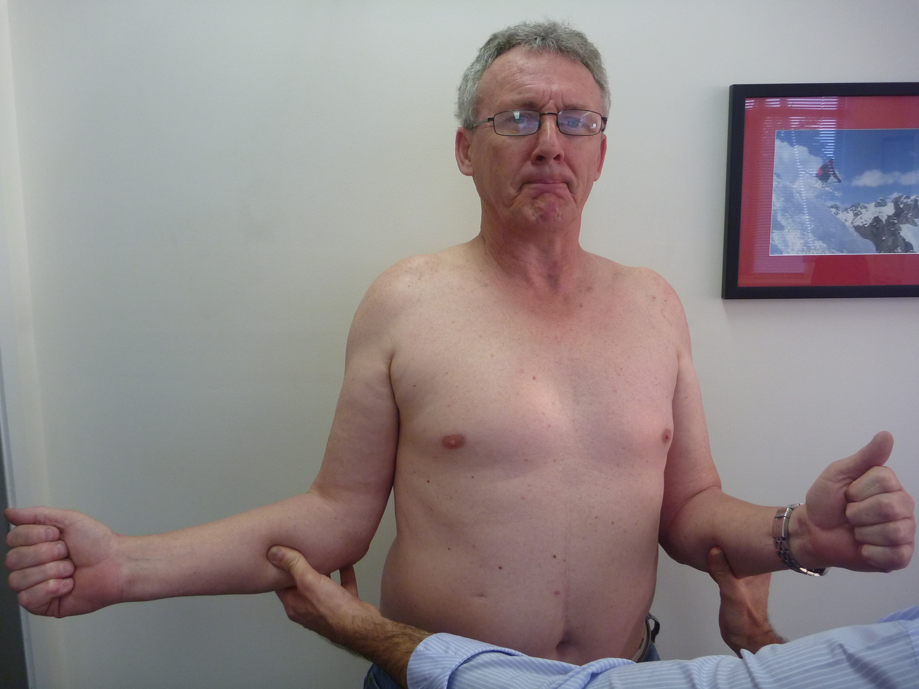

Slide 36
Loss of Passive Movement
Frozen shoulder
Osteoarthritis
X-ray
Arthritis
Normal (very!)
Frozen shoulder
OA

Slide 37
FROZEN SHOULDER - investigations
X-ray to exclude osteoarthritis
Does not need a ultrasound – may show asymptomatic pathology & very unreliable

Slide 38
FROZEN SHOULDER -TREATMENT
Nothing – time
AVOID STRETCHING – makes it worse!!!
Intra-articular steroids
Analgesics including NSAID
MUA
Arthroscopic release

Slide 39
FROZEN SHOULDER
Best treatment is early steroid injection – refer to radiologists (or me!) as quite painful

Slide 40
FROZEN SHOULDER
What about frozen shoulder with other pathology such as rotator cuff tears?

Slide 41
Frozen shoulder & Cuff Tears
With significant trauma as the cause
Needs MRA to exclude large tear
If tear has caused frozen shoulder
- needs repair (sometimes urgently)
Without significant trauma
Ignore cuff pathology

Slide 42
Subacromial Bursitis (Impingement Syndrome)
And
Rotator cuff tears

Slide 43
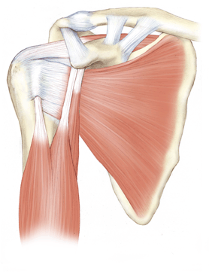

Slide 44
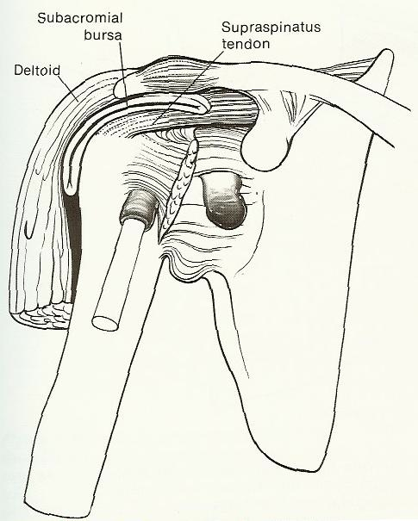

Slide 45
Rotator Cuff Muscles
The key landmark to remember the muscles and actions is the spine of the scapula which is posterior
Infraspinatus
Posterior therefore an external rotator
Supraspinatus
Superior therefore an elevator
Subscapularis
Anterior therefore an internal rotator

Slide 46
Subacromial Bursitis / Impingement Syndrome / Rotator cuff tears
The villain is …………

Slide 47
“Age related degenerative change” !
“Everyone gets it - It’s like grey hair and wrinkles on your face”
At least half of all humans have a cuff tear at the time of death- most asymptomatic

Slide 48
“Age related degenerative change”
It causes …..
Degeneration of cuff
Bursitis
Rotator cuff tears
Spurs
Biceps tendon pathology

Slide 49
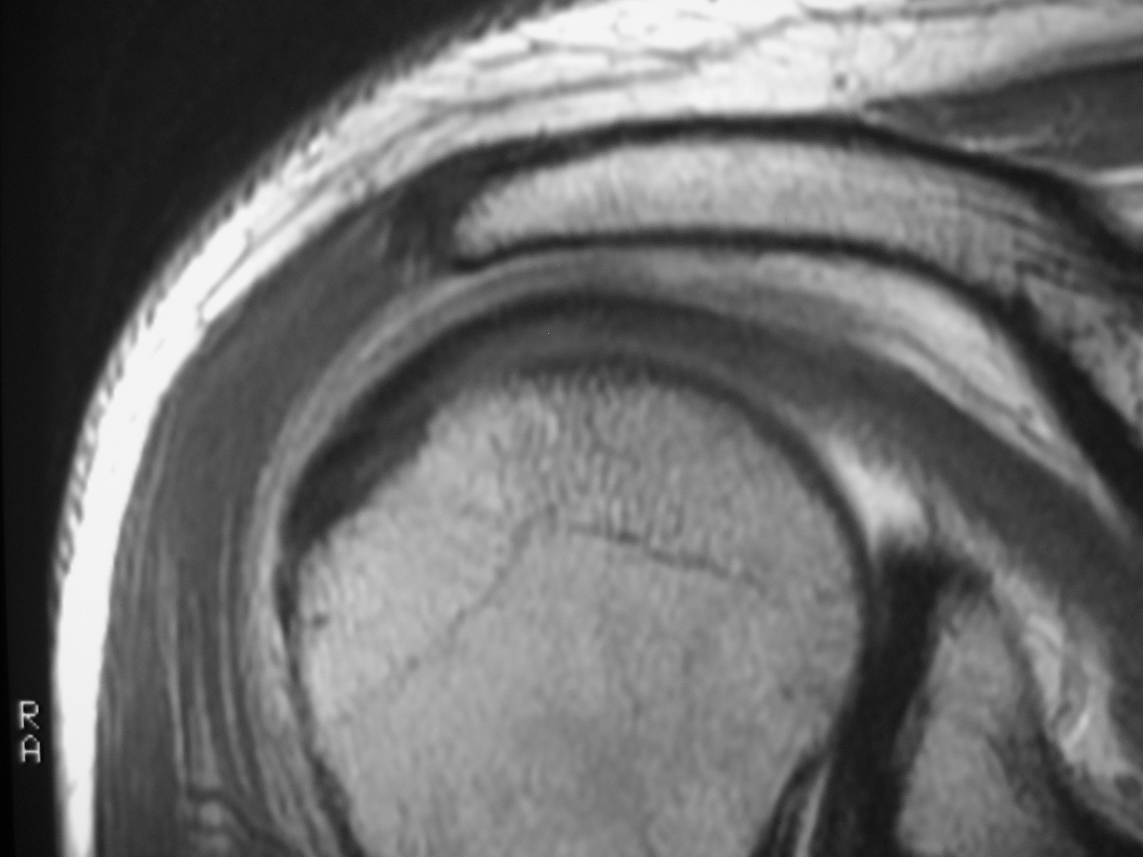
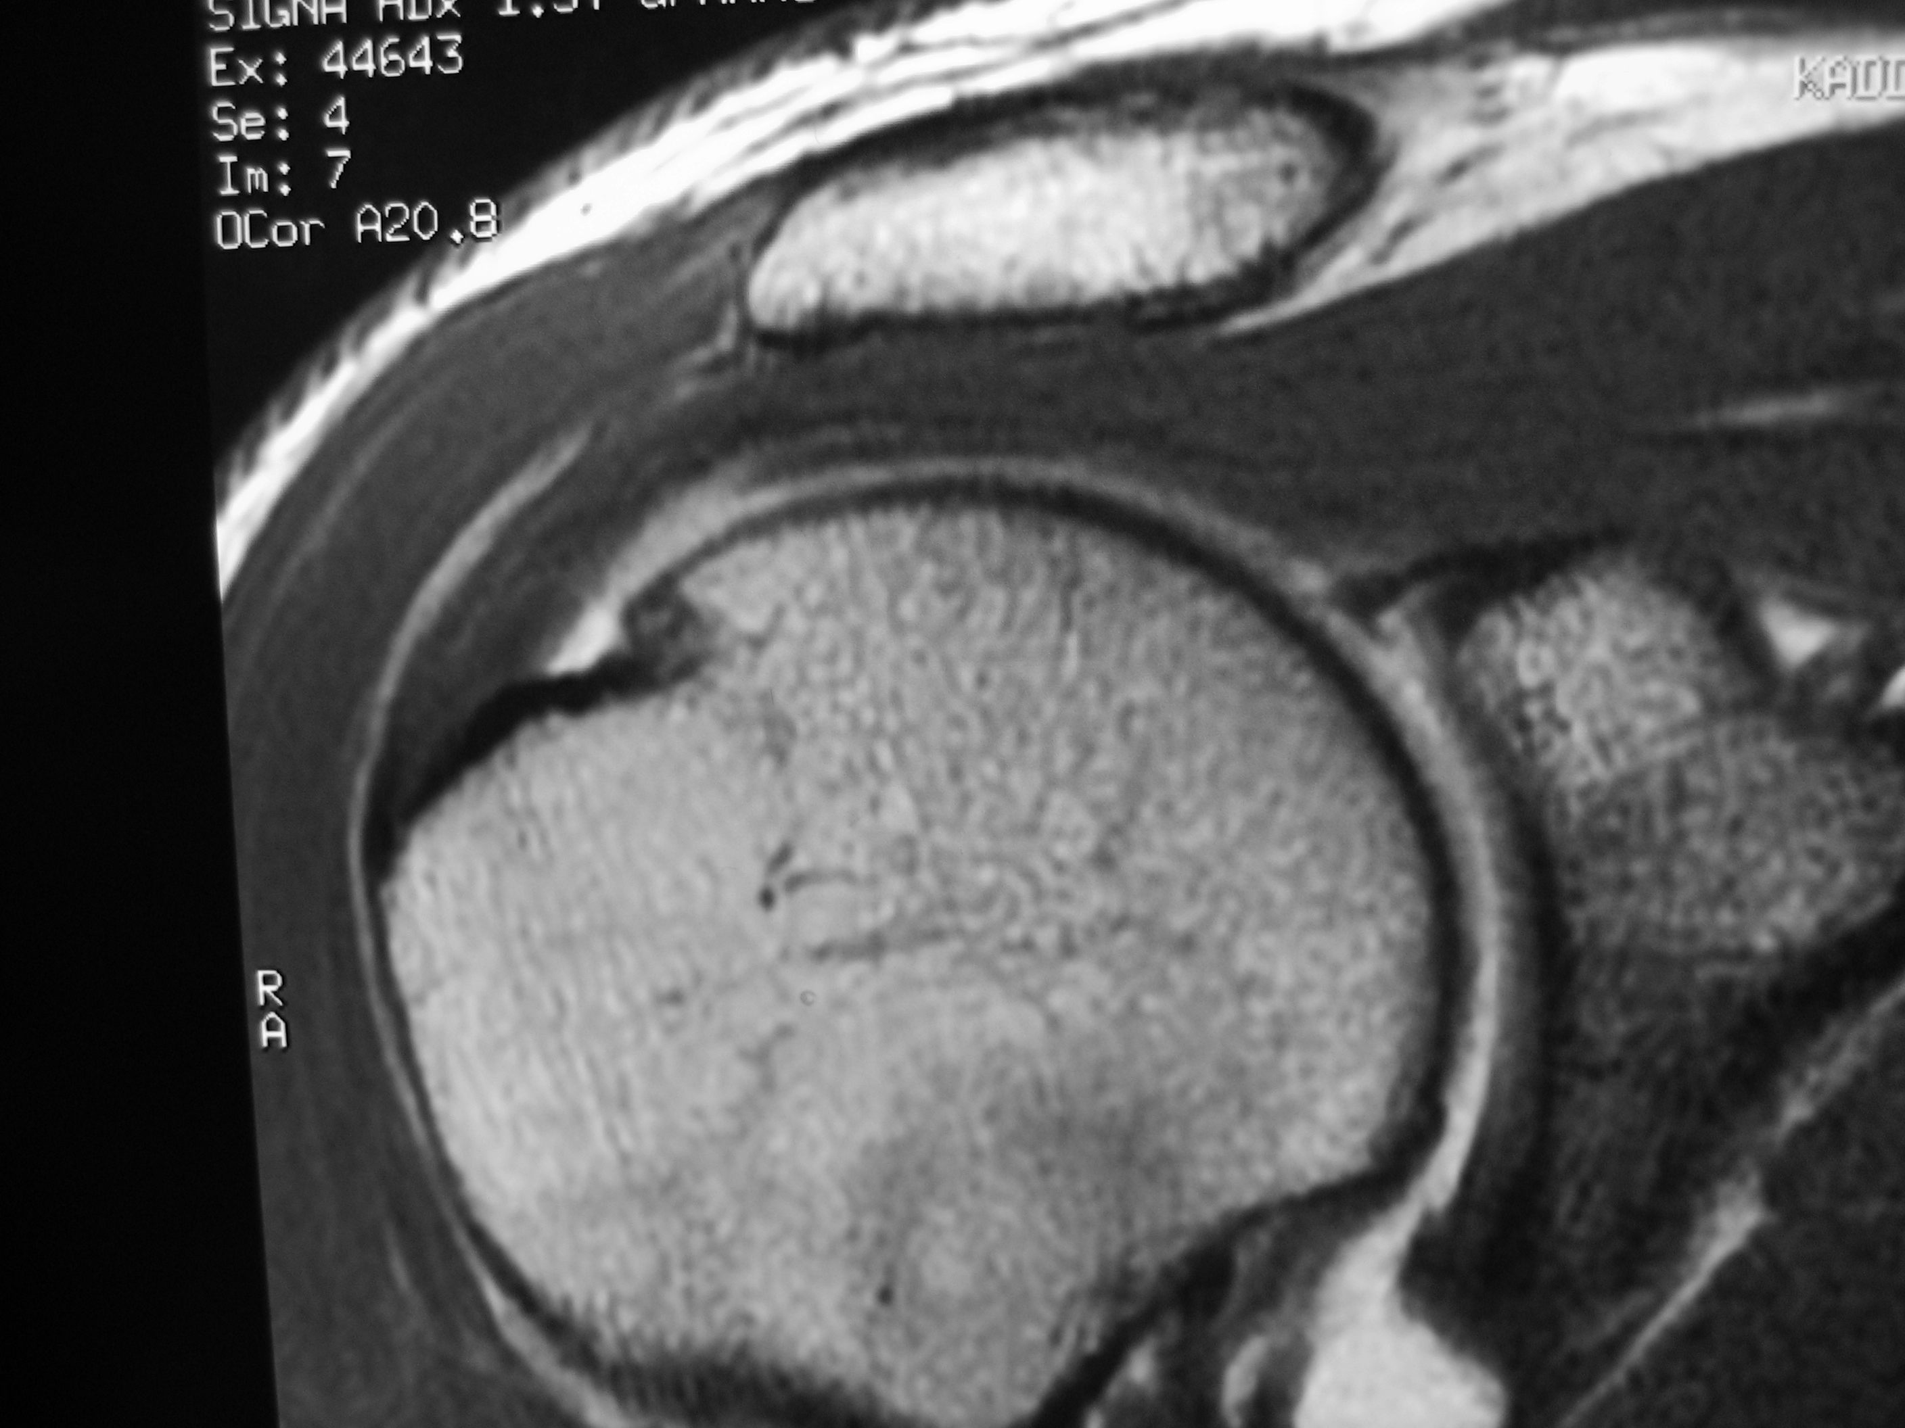

Slide 50
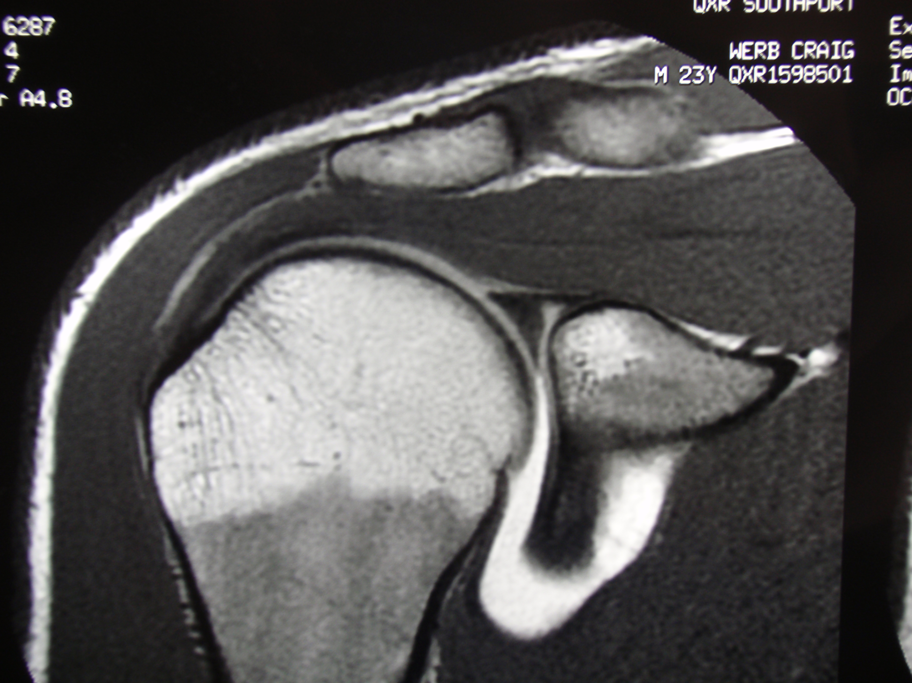
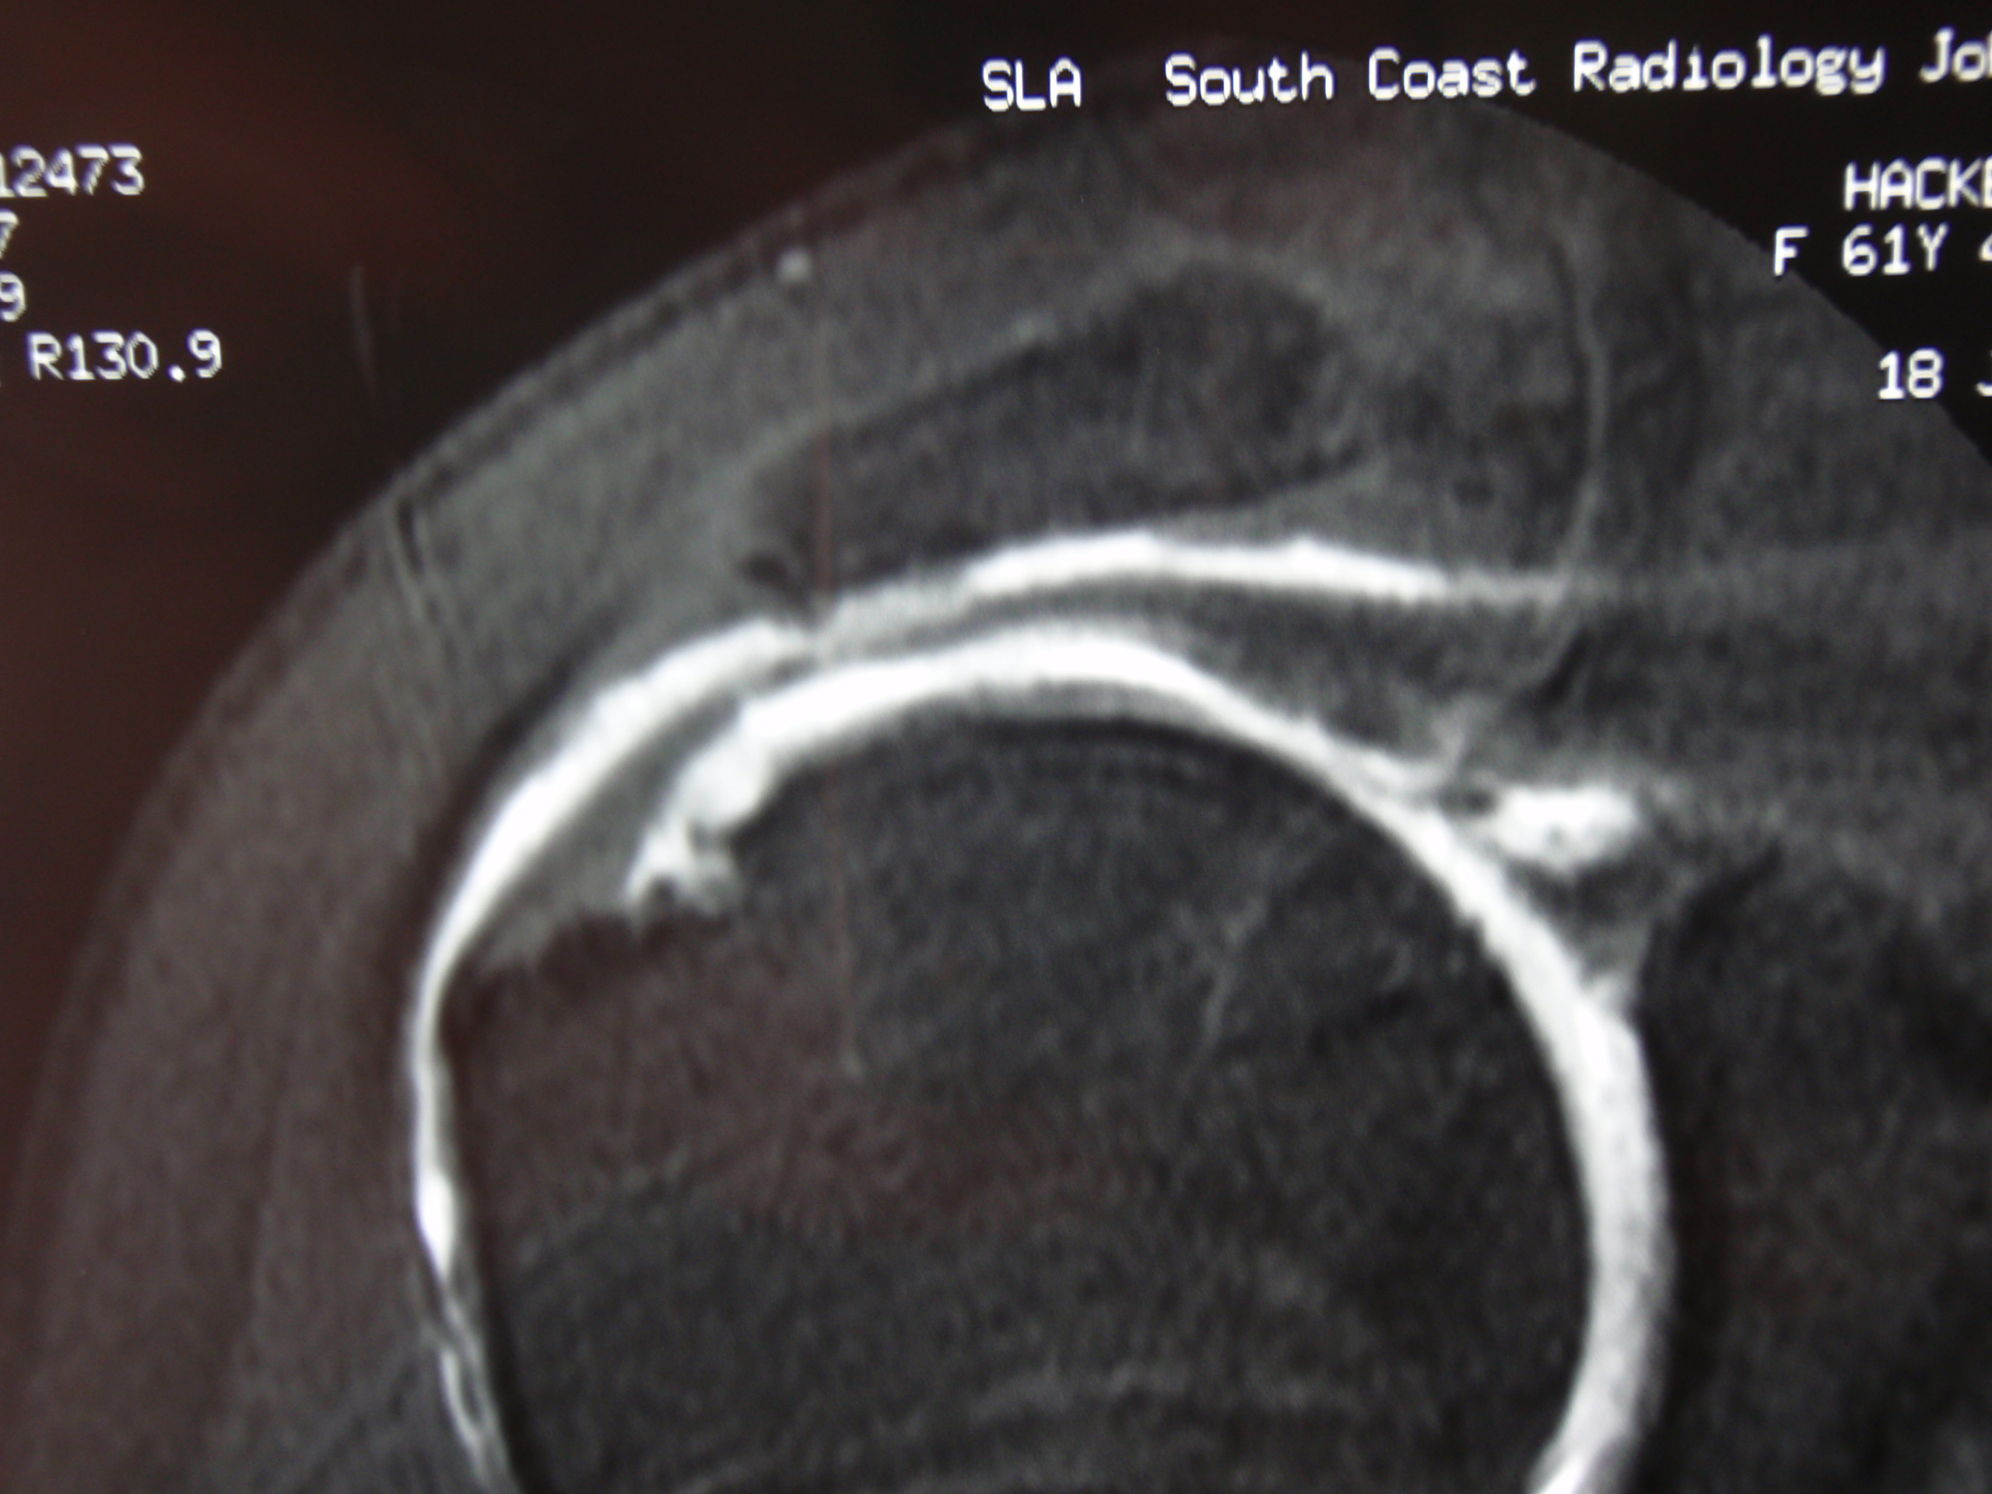

Slide 51
Bursitis - pain
Small rotator cuff tears - more pain
Large rotator cuff tears- weakness
Very large cuff tears – can’t lift arm
arthritis (4% of tears)

Slide 52
Subacromial Bursitis = Impingement Syndrome
We used to assume the bursitis was from the rotator cuff ‘impinging’ on the acromion hence ‘impingement syndrome’ – probably not true
Therefore subacromial bursitis probably a better term

Slide 53
Partial Tears Vs Full Tears
The proper terms are partial THICKNESS tear and full THICKNESS tear
A partial thickness tear is really just wear and tear with no actual hole in it.
A full thickness tear has a hole right through it.

Slide 54
Trauma
Bursitis
“Post – traumatic subacromial bursitis”
Cuff Tears
Acute
Acute on chronic

Slide 55
Trauma and Cuff Tears
Be very careful in anyone with significant trauma and sudden loss of function
Suspect a large cuff tear that needs urgent surgery
- Very common with dislocations and falls in older patients

Slide 56
Bursitis / Cuff Tears - Symptoms
Pain
- night – wakes patients
- worse with overhead use, reaching,
lifting
- NOT numbness, pain in hand, pain
with neck movements

Slide 57
Bursitis / Cuff Tears - Signs
Tendernes of greater tuberosity
Impingement signs
Weakness with tear
NOT
- stiffness (loss of passive movement)

Slide 58
Bursitis / Cuff Tear Investigations
X-ray
- very useful
- ask for shoulder x-rays -
“ ? cuff tear ”

Slide 59
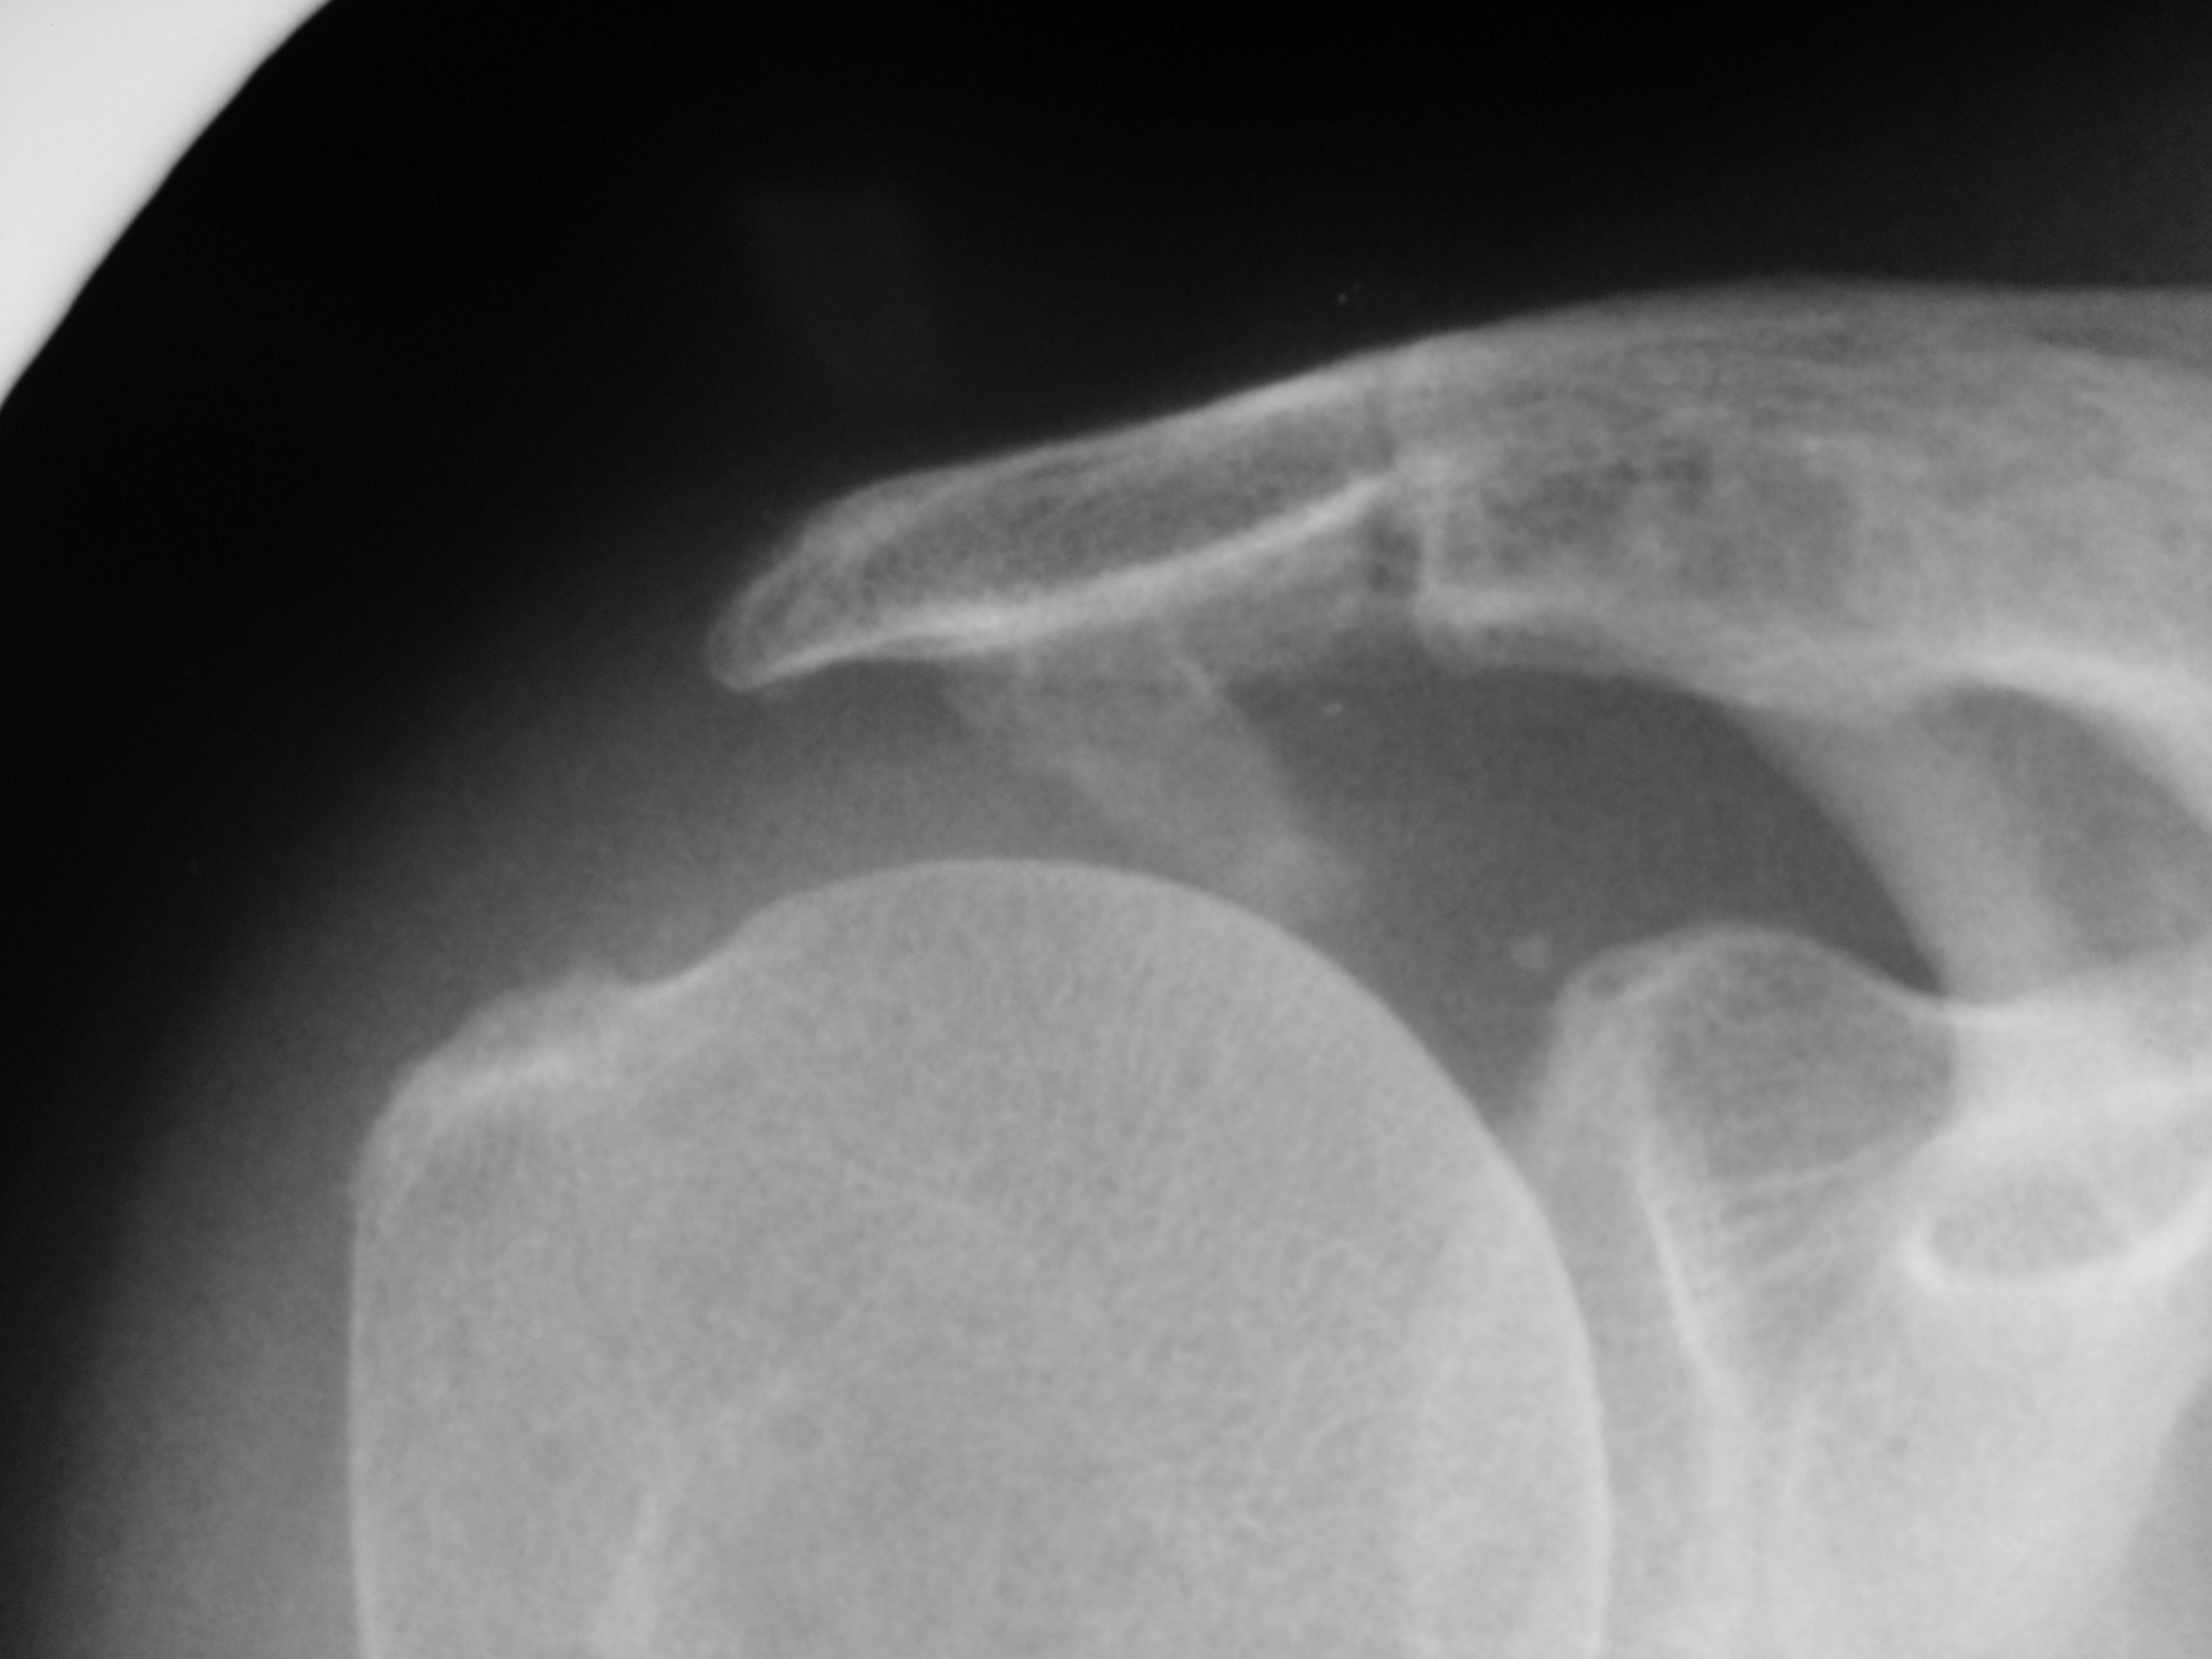

Slide 60
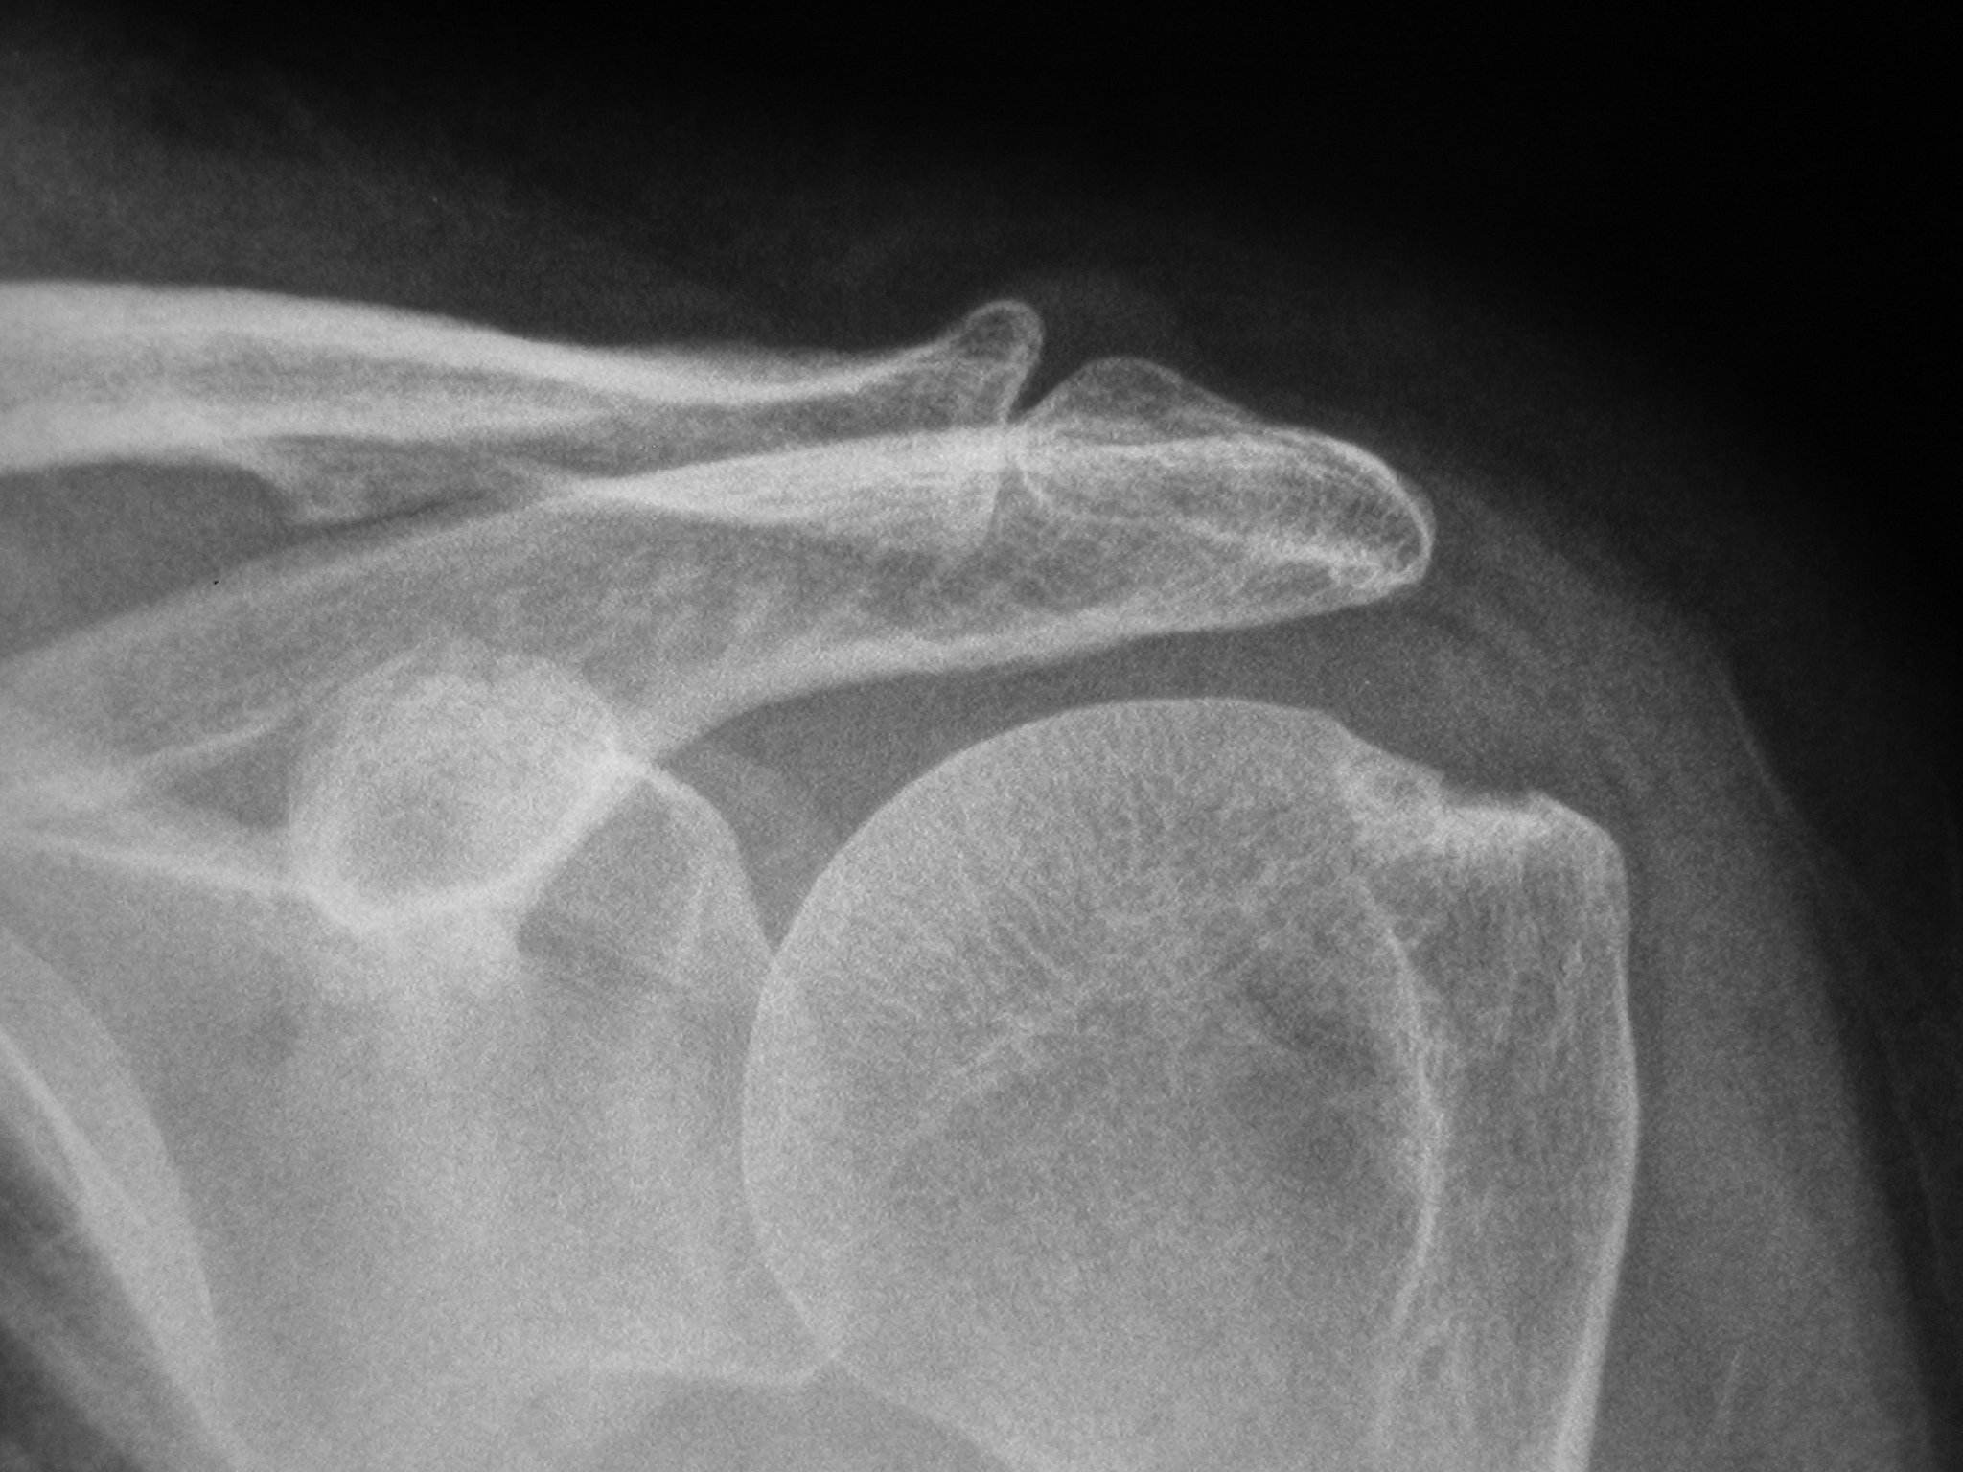

Slide 61
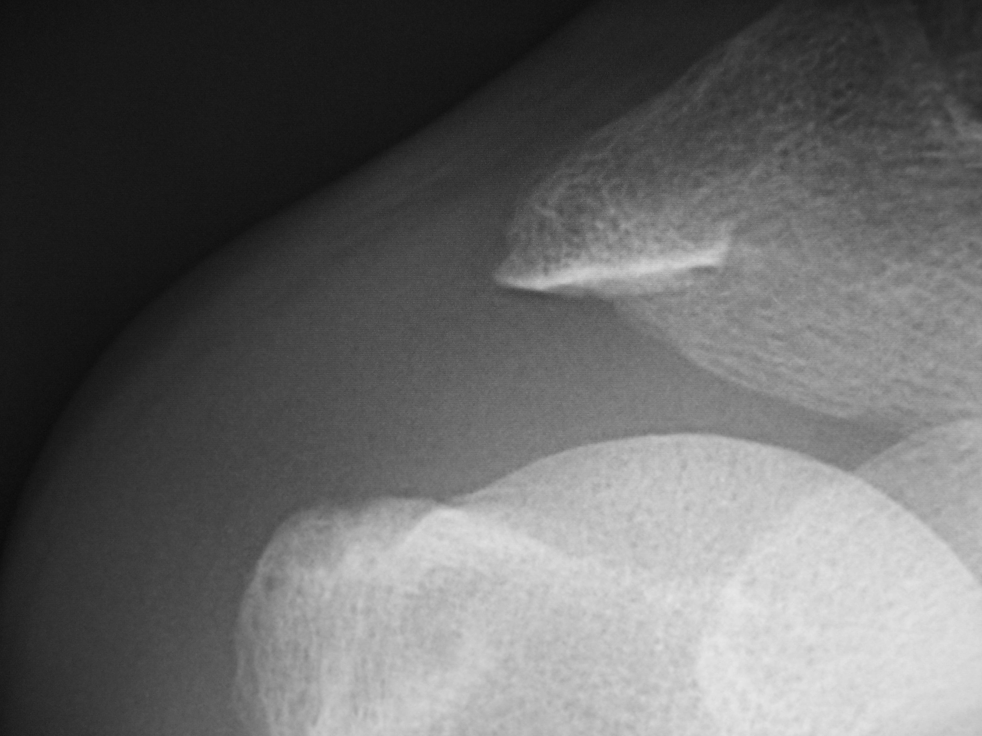

Slide 62
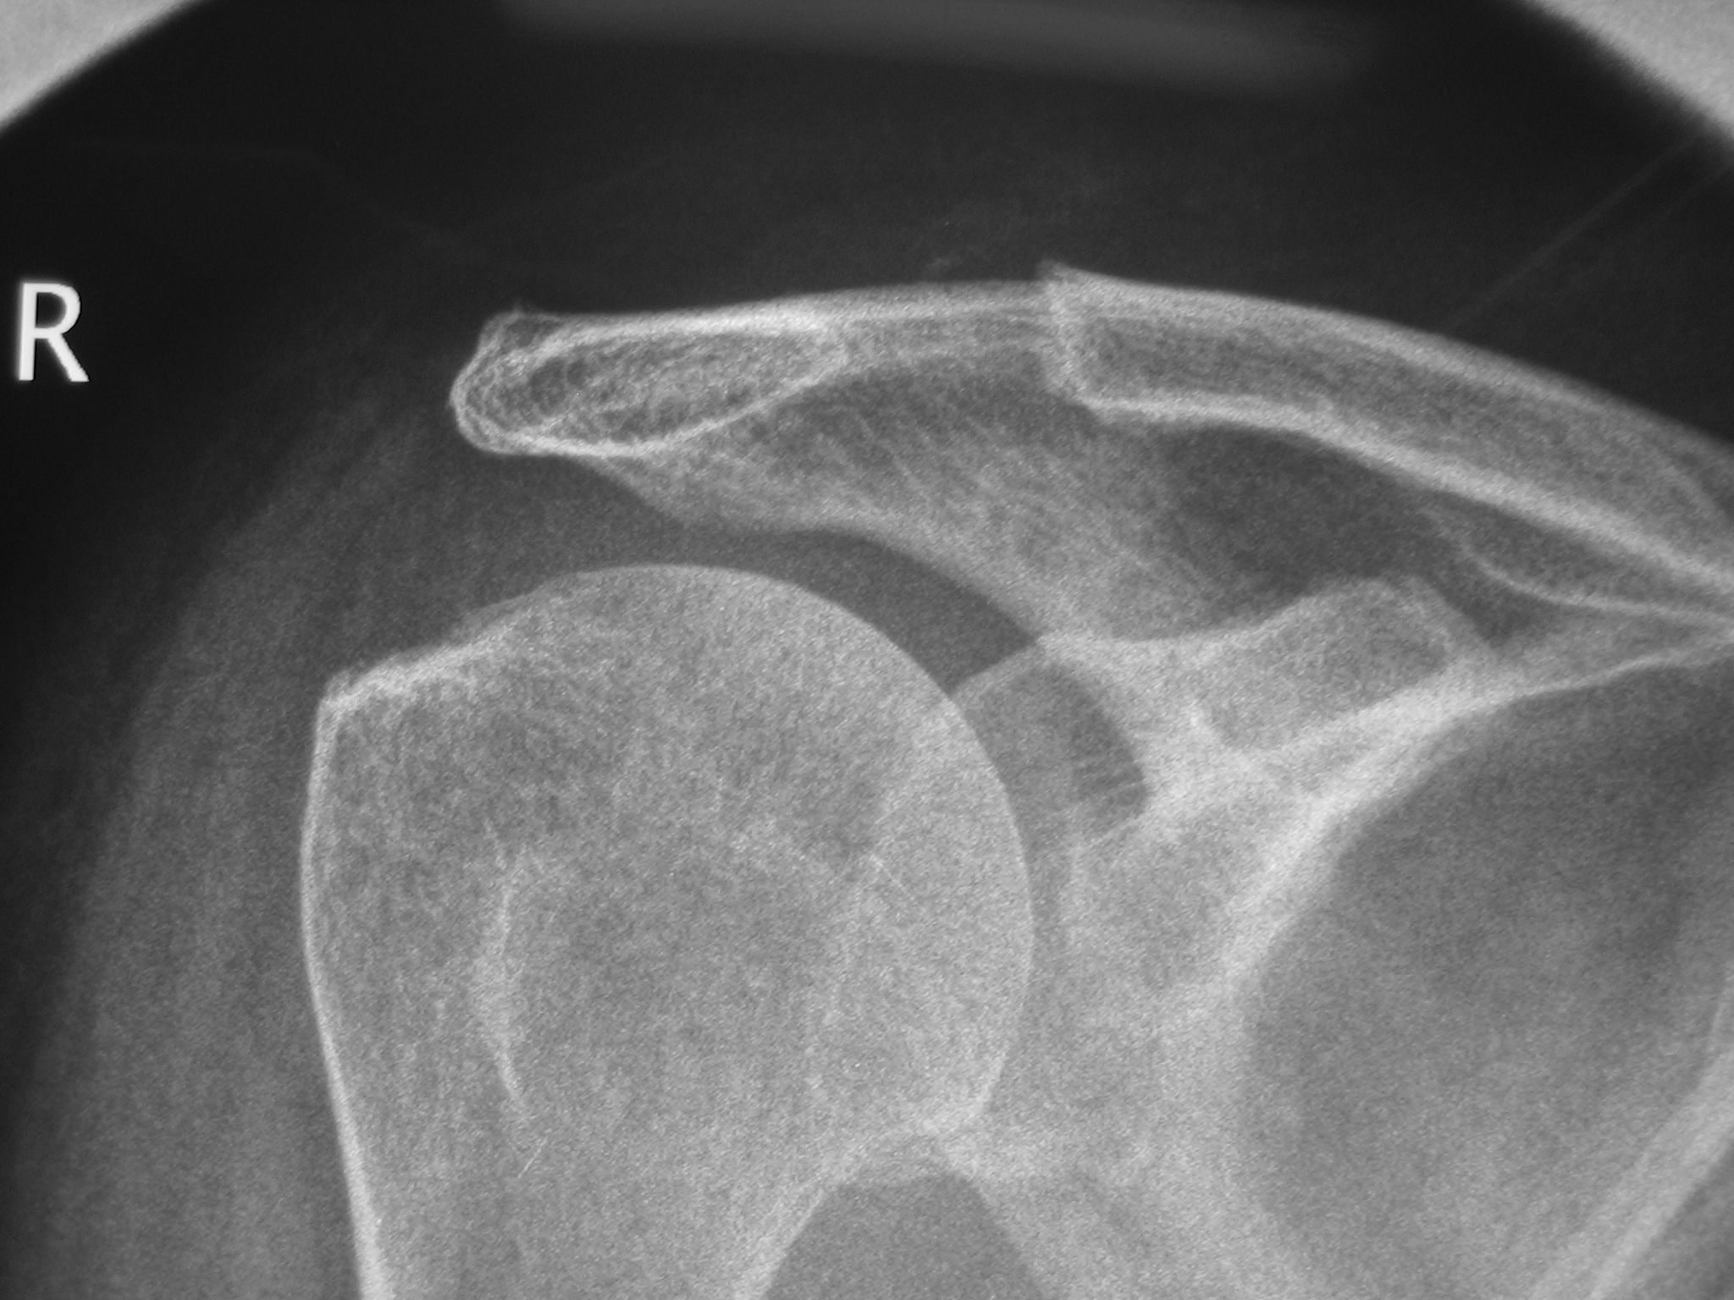
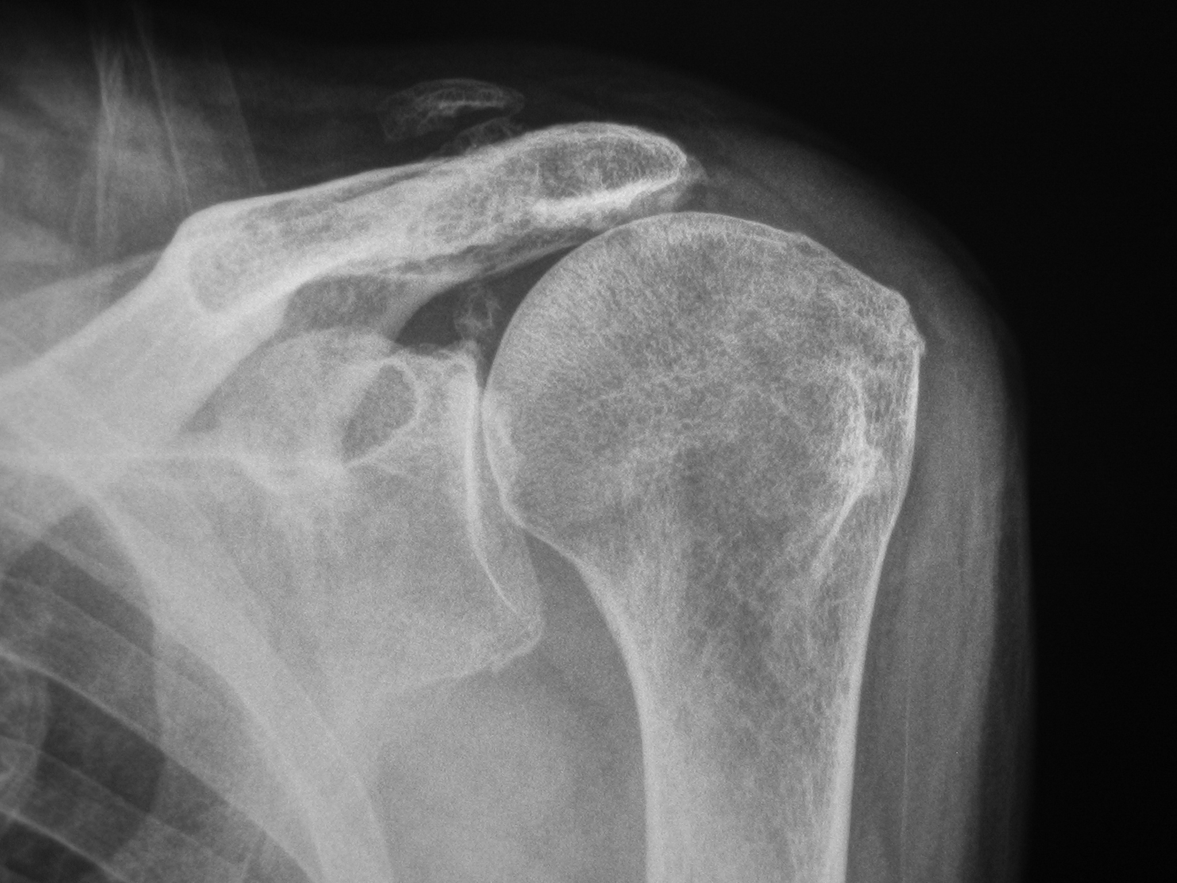
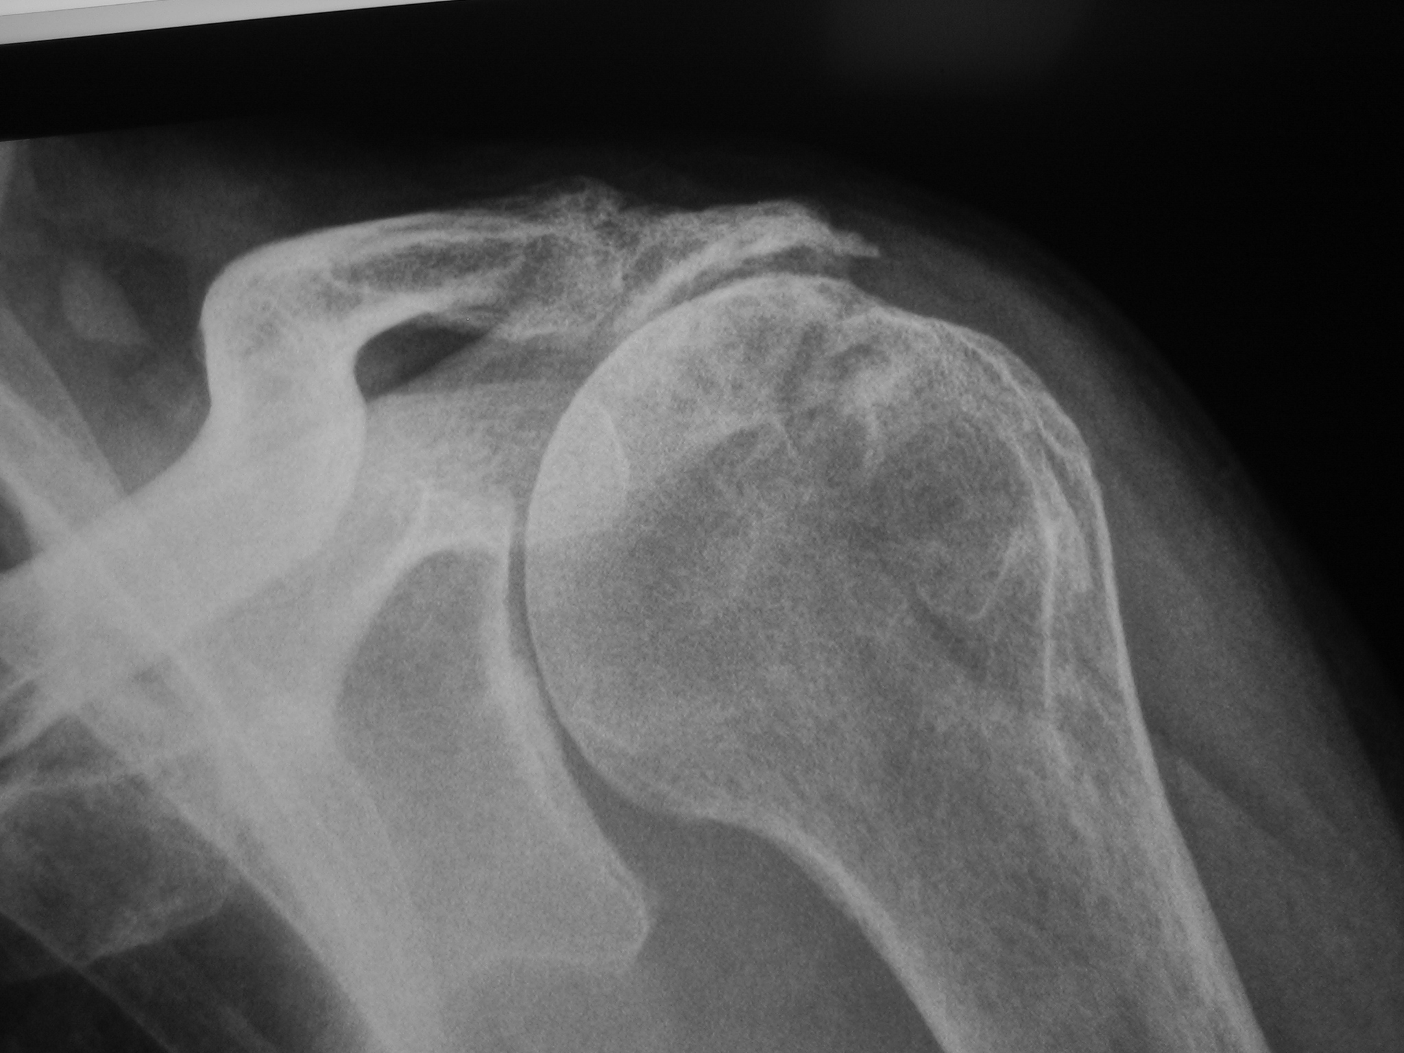
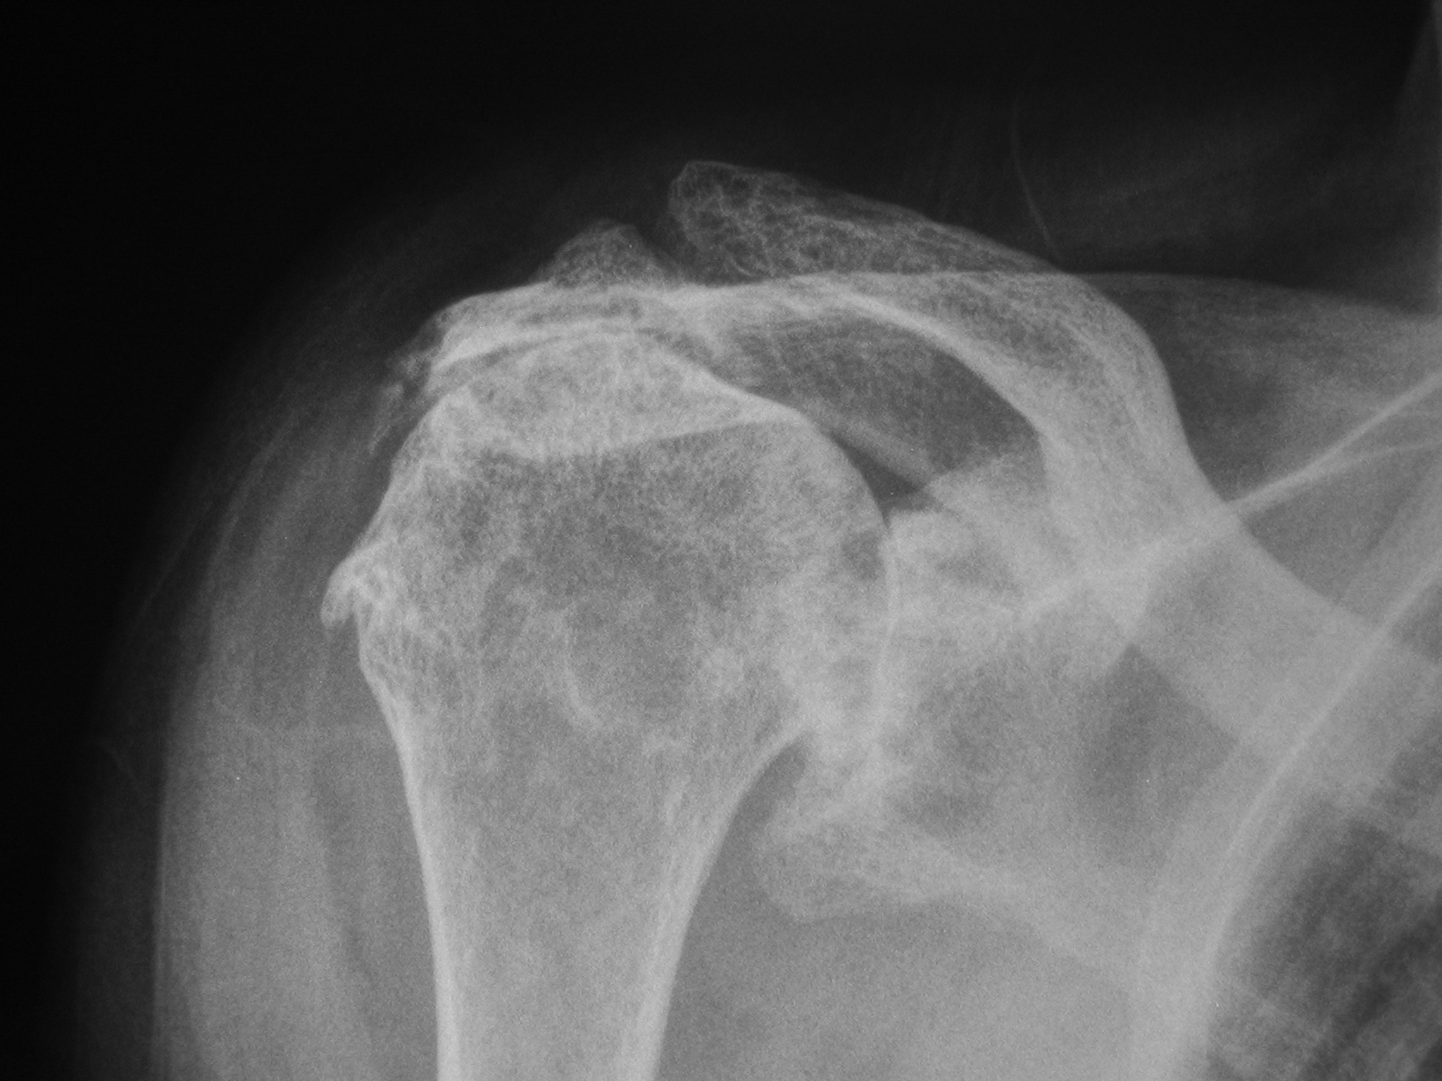

Slide 63
Bursitis / Cuff Tear Investigations
Ultrasound
- cheap, non-invasive
BUT
- unreliable
- “full thickness tear” – 75% accurate
- “partial thickness tear” – IGNORE!!!

Slide 64
Bursitis / Cuff Tear Investigations
MRI (I always do MR Arthrogram)
- very accurate for full
thickness tears
- look on T1 weighted coronal
image

Slide 66
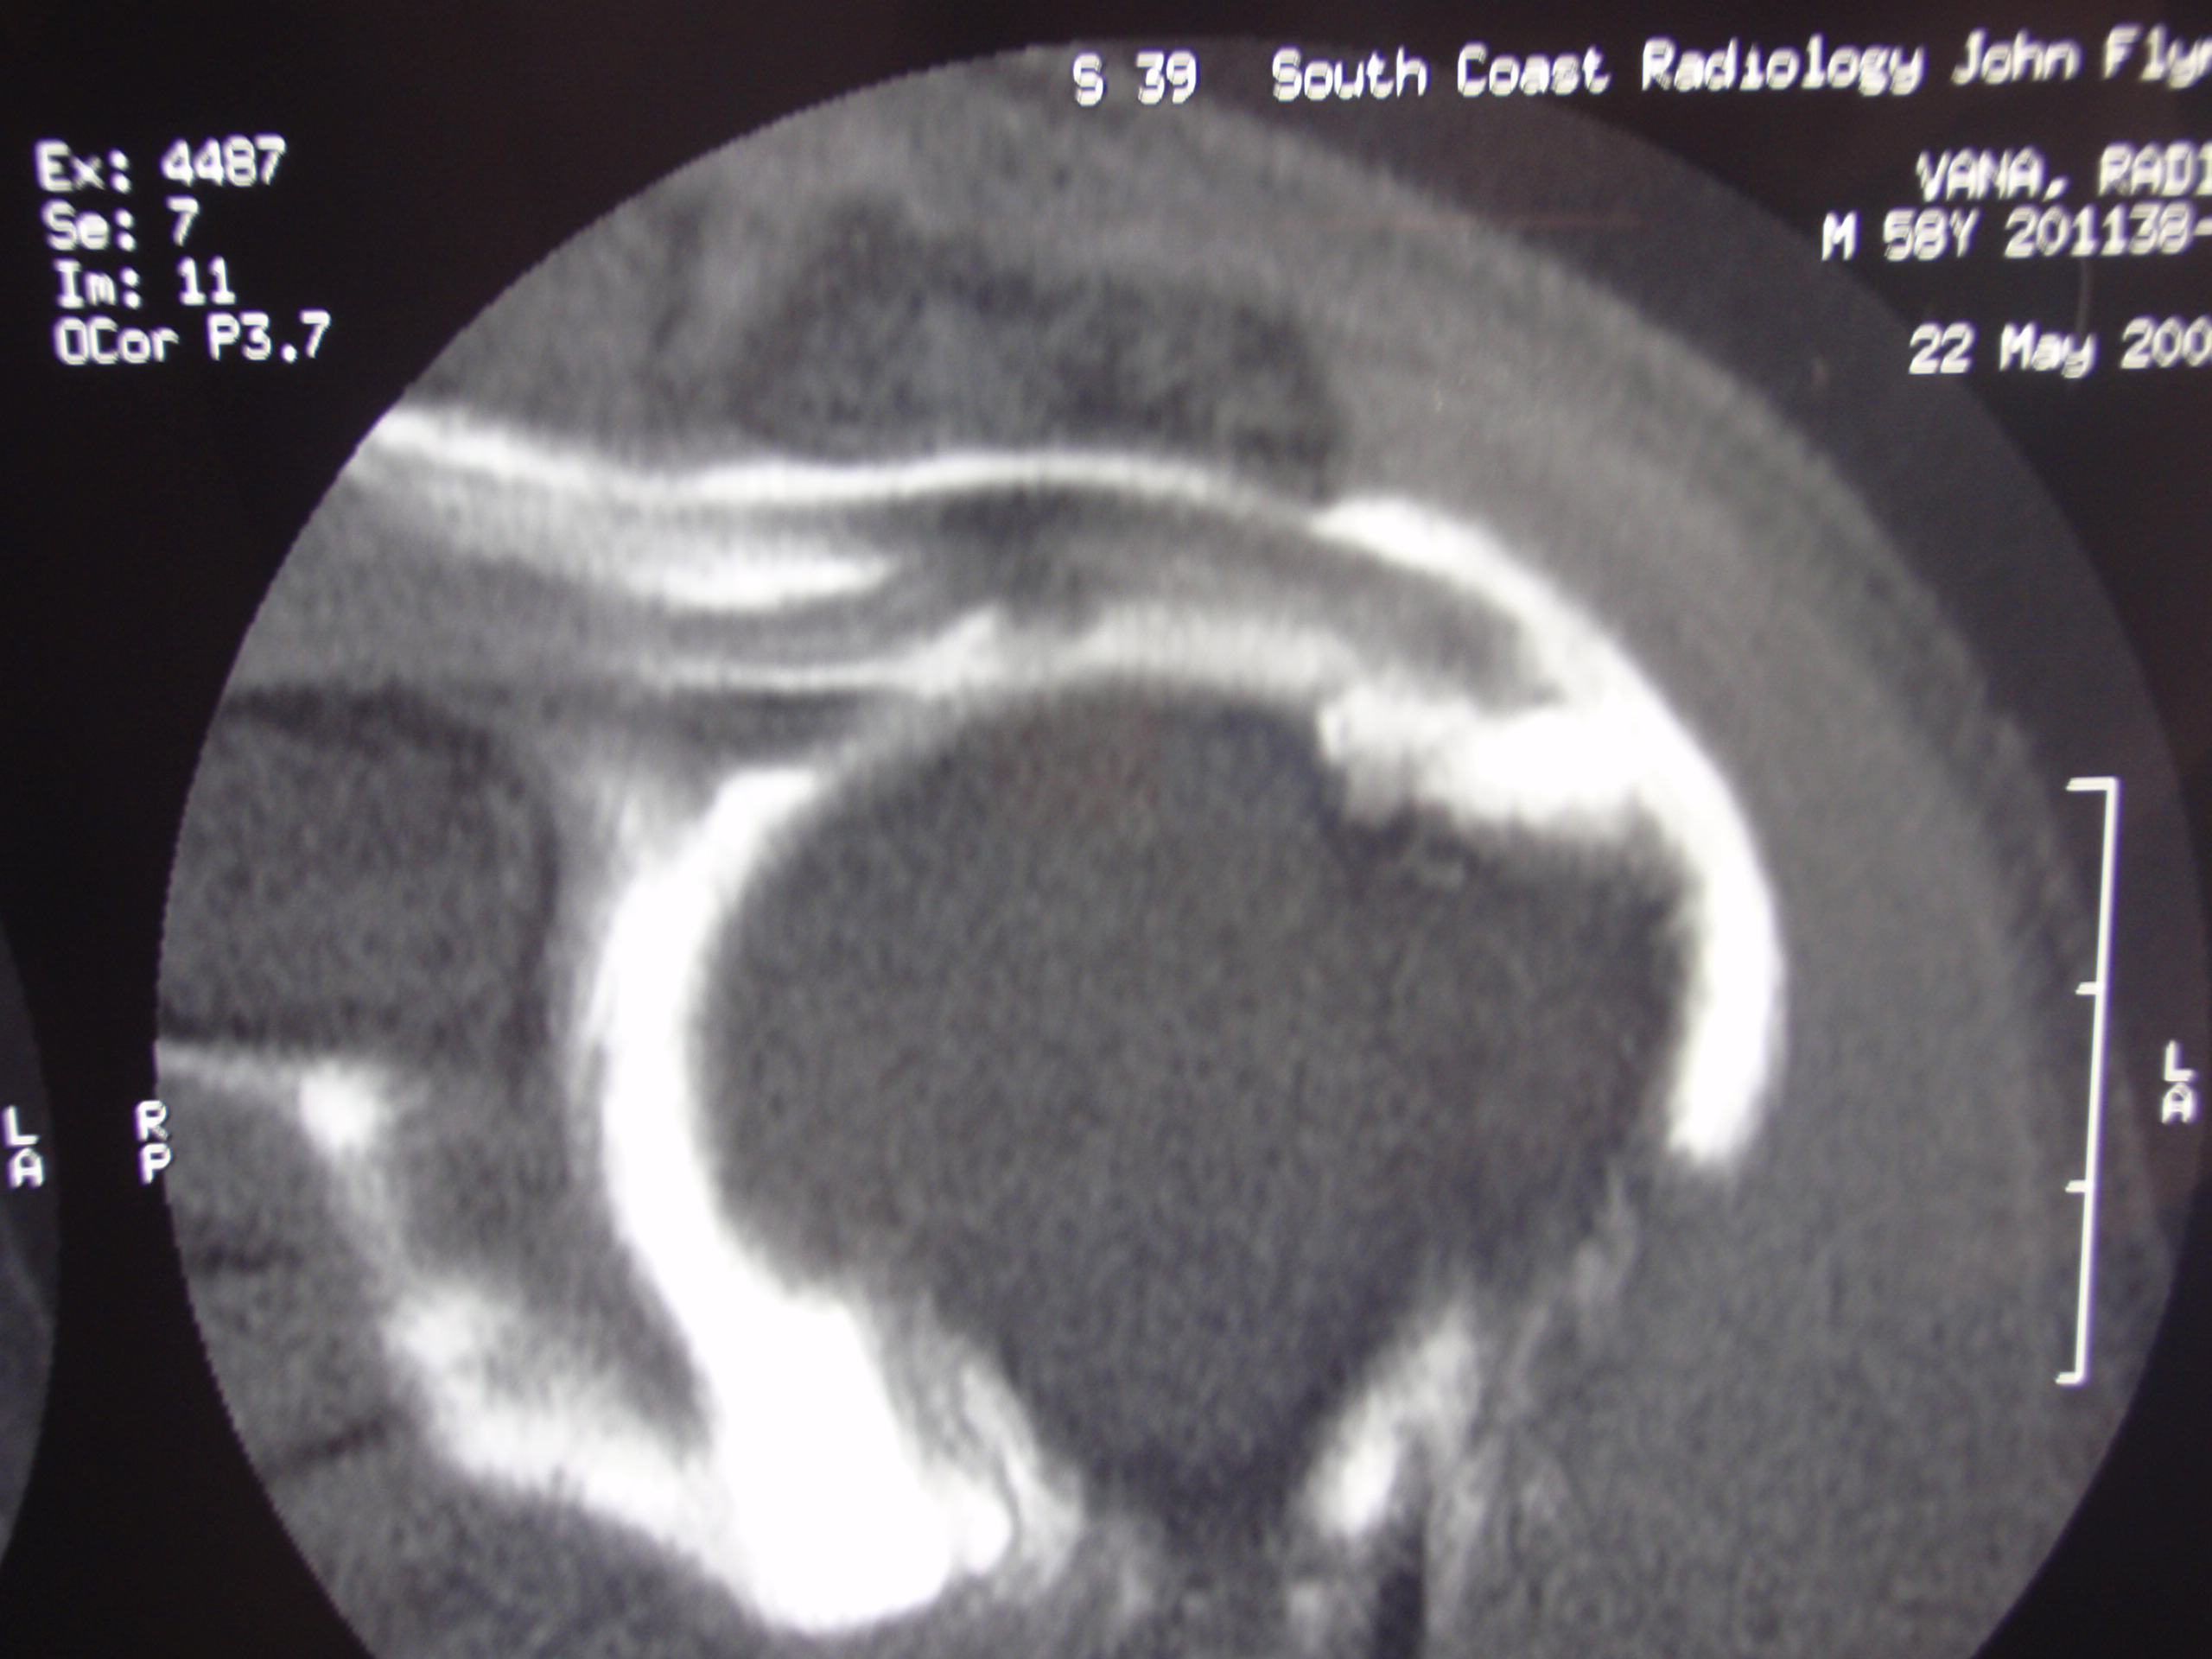

Slide 67
Bursitis / Cuff Tears - Treatment
Acute traumatic cuff tears
- need urgent treatment within a few weeks
All other bursitis / cuff tears
- all treatment is symptomatic
- if can treat satisfactorily without surgery, then
continue to do so

Slide 68
Bursitis / Cuff Tears - Treatment
Avoid activities that make it worse
Rest – decrease work activities
Tablets - paracetamol (Panadol Osteo)
- anti – inflamatories
Cortisone injections – very good
Try physio – stop if it makes it worse
Surgery if non-operative treatment fails

Slide 69
Bursitis / Cuff Tears - Treatment
Generally try non-operative treatment for at least 3 months before considering surgery
It may resolve in 3 months and this gives enough time to ensure that it is the correct diagnosis (NOT frozen shoulder for example)

Slide 70
Surgery
All patients get arthroscopic subacromial decompression initially
- acromiplasty and bursectomy
- allows assessment of joint and treatment of other conditions – cuff, biceps , ACJ etc
- if no cuff tear then no open procedure required therefore quick rehab, minimal pain

Slide 71
Surgery
Proceed to cuff repair if required
- done arthrscopically or open –
whatever gives best repair

Slide 72
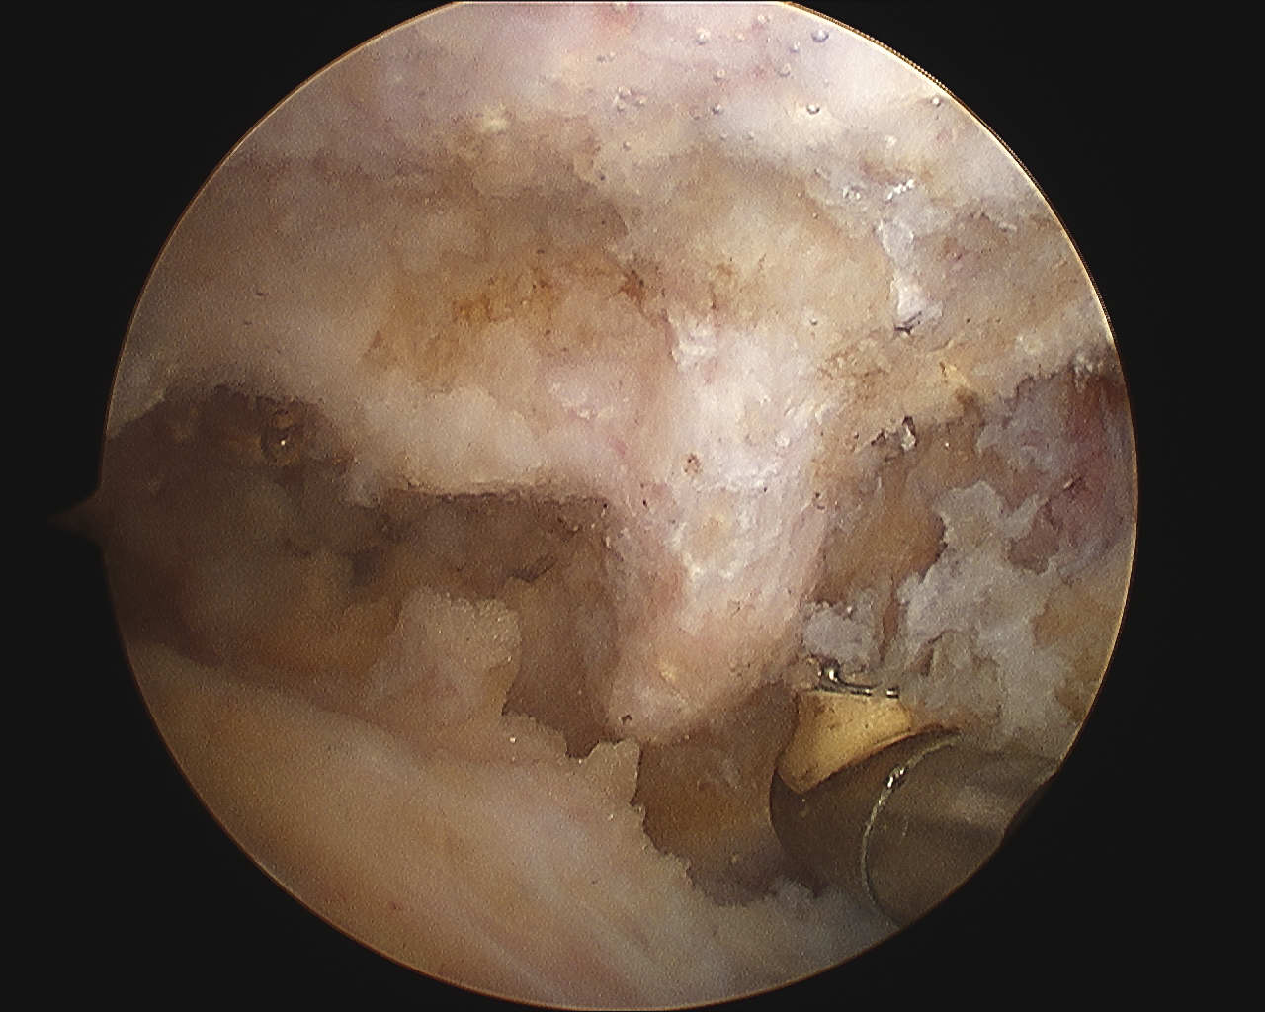

Slide 73
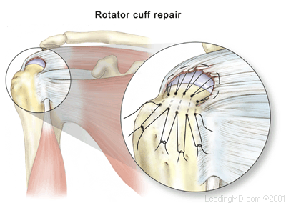

Slide 74
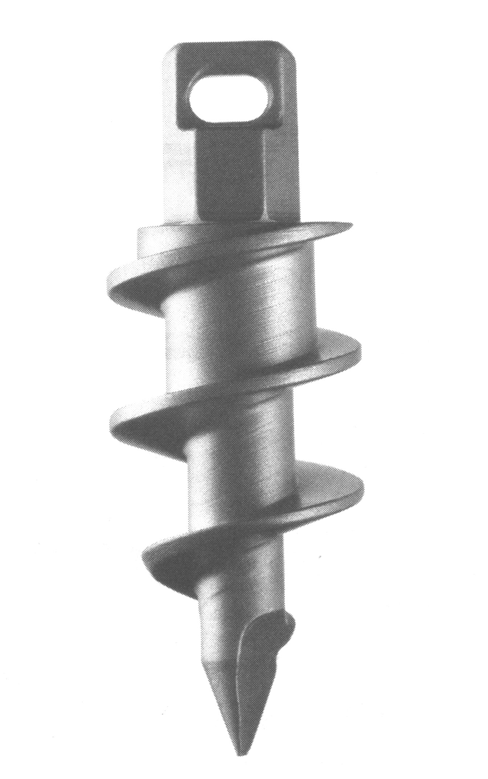

Slide 75
Rotator Cuff Repair - Rehabilitation
Is stiffness a problem?
NO!
Stiffness is universal and is your friend!

Slide 76
Rotator Cuff Repair
Re-tears common
- 20 – 40 %
Long term stiffness
- VERY RARE

Slide 77
Rotator Cuff Repair - Rehabilitation
Always err on the side on very slow
rehabilitation
Do not force anything!

Slide 78
Bursitis / Cuff Tears
I had an ultrasound – it shows a tear – do I need surgery?
Only if non-operative treatments haven’t worked
Remember – ultrasounds are often WRONG!

Slide 79
Bursitis / Cuff Tears
If I have a full thickness tear does that mean I need surgery?
No – treatment is always based on how much trouble it gives you. If you can manage, then surgery may not be needed.

Slide 80
Bursitis / Cuff Tears
The ultrasound says I have 2 (or more) muscles torn – what does that mean?
There is still only one tear – it’s just that it will be quite a big tear and involves the part of the rotator cuff joined to 2 (or more) muscles.

Slide 81
Bursitis / Cuff Tears
What is ‘rotator cuff tear arthropathy”?
Arthritis in glenohumeral joint secondary to a large irreparable cuff tear. Rare – only 4% of cuff tears. Gives marked pain and loss of function. Diagnosed by x-ray with loss of joint space and humeral head riding up and eroding acromion.
Treated with reverse shoulder replacement.

Slide 83
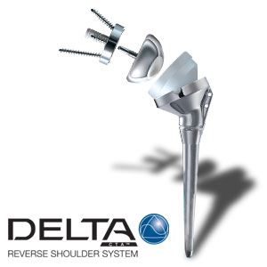

Slide 84
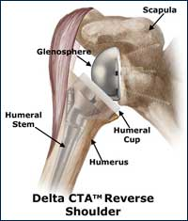

Slide 85
Bursitis / Cuff Tears
What can be done with a large tear that can’t be repaired?
Unfortunately not much. Large tendon transfers (lat dorsi transfer), artificial grafts aren’t reliable, reverse prosthesis only for >70 years old.
Refer to physios and pain management specialists

Slide 86
Biceps Tendon Problems

Slide 87
Biceps Tendon Problems
Just a reminder …
Shoulder problems involve the proximal biceps - “long head of biceps”
Distal biceps tears (at the elbow) need surgical repair which should be done as soon as possible

Slide 88
Short head of biceps – never tears
Long head of biceps- often tears!
Biceps

Slide 89
Biceps Tendon Problems
Tendonopathy
- really just degenerative disease
similar to rotator cuff disease
- indistinguishable from bursitis
- over-diagnosed in young
- treat symptomatically

Slide 90
Complete Long Head of Biceps Tear
Often relieves pain from a degenerate tendon - the tendon no longer has force on it and pain is gone
Virtually no loss of function – only issue is cosmetic deformity

Slide 91
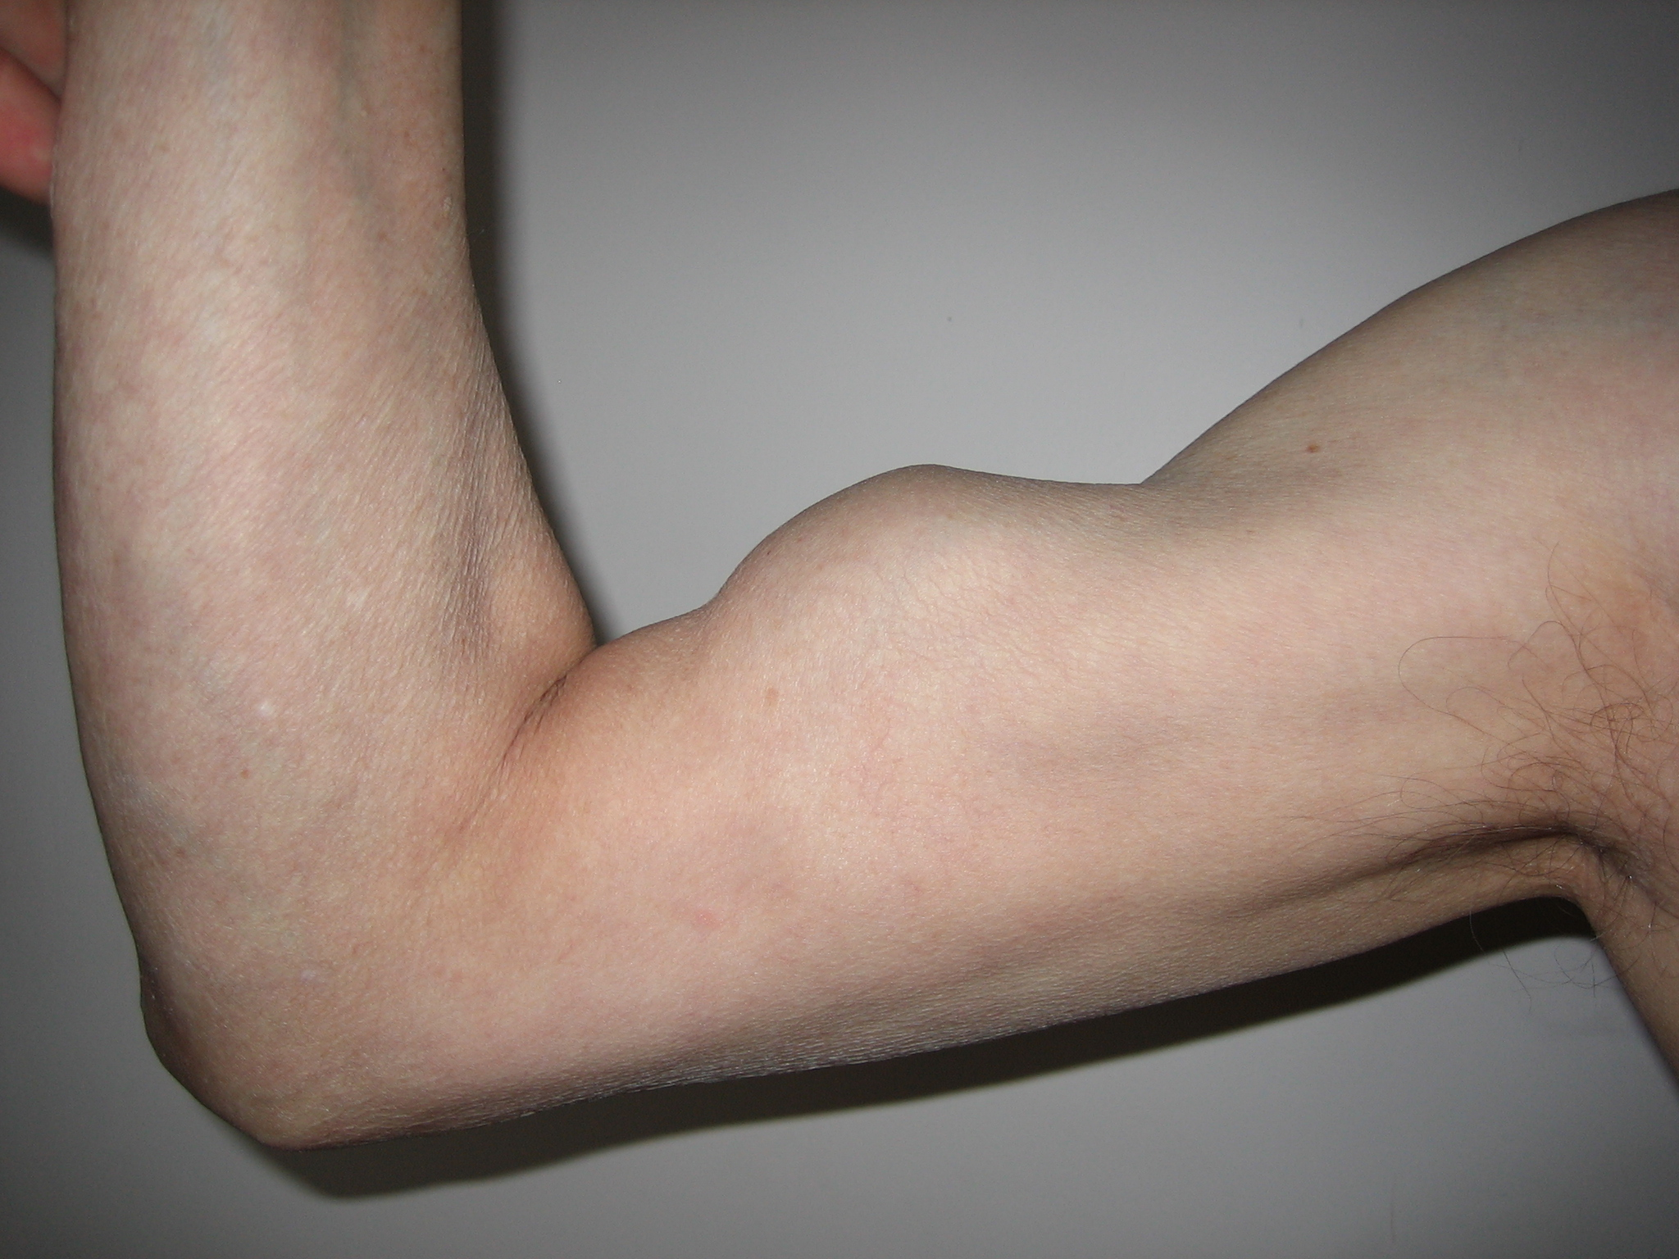
“Popeye Sign” from torn long head of biceps

Slide 92
Biceps tears
Do not need repair unless traumatic in athletes (very rare)
Often is a sign of tear of the rotator cuff – ‘anterio-superior tear’ involving some of subscapularis and supraspinatus (which may need repair)

Slide 93
Biceps Tendon Problems
Partial Tears
- indistinguishable from bursitis
- can really only diagnose at surgery
- treat symptomatically
- surgery - divide the biceps
- tenotomy in older patients
- transfer (‘tenodesis’) in young to
avoid cosmetic deformity

Slide 94
Acromioclavicular Joint Problems

Slide 97
Acromioclavicular Joint Problems
Young patients
‘Osteolysis of the distal clavicle’
- overuse injury (often heavy
weight lifters
- causes degenerative disease of
ACJ

Slide 98
Acromioclavicular Joint Problems
Older patients
Osteoarthritis of ACJ
- often asymptomatic

Slide 99
Acromioclavicular Joint Symptoms
Hard to distinguish from other shoulder problems but patients definitely tend to localize to ‘top’ of shoulder
Pain and tenderness over the joint

Slide 100
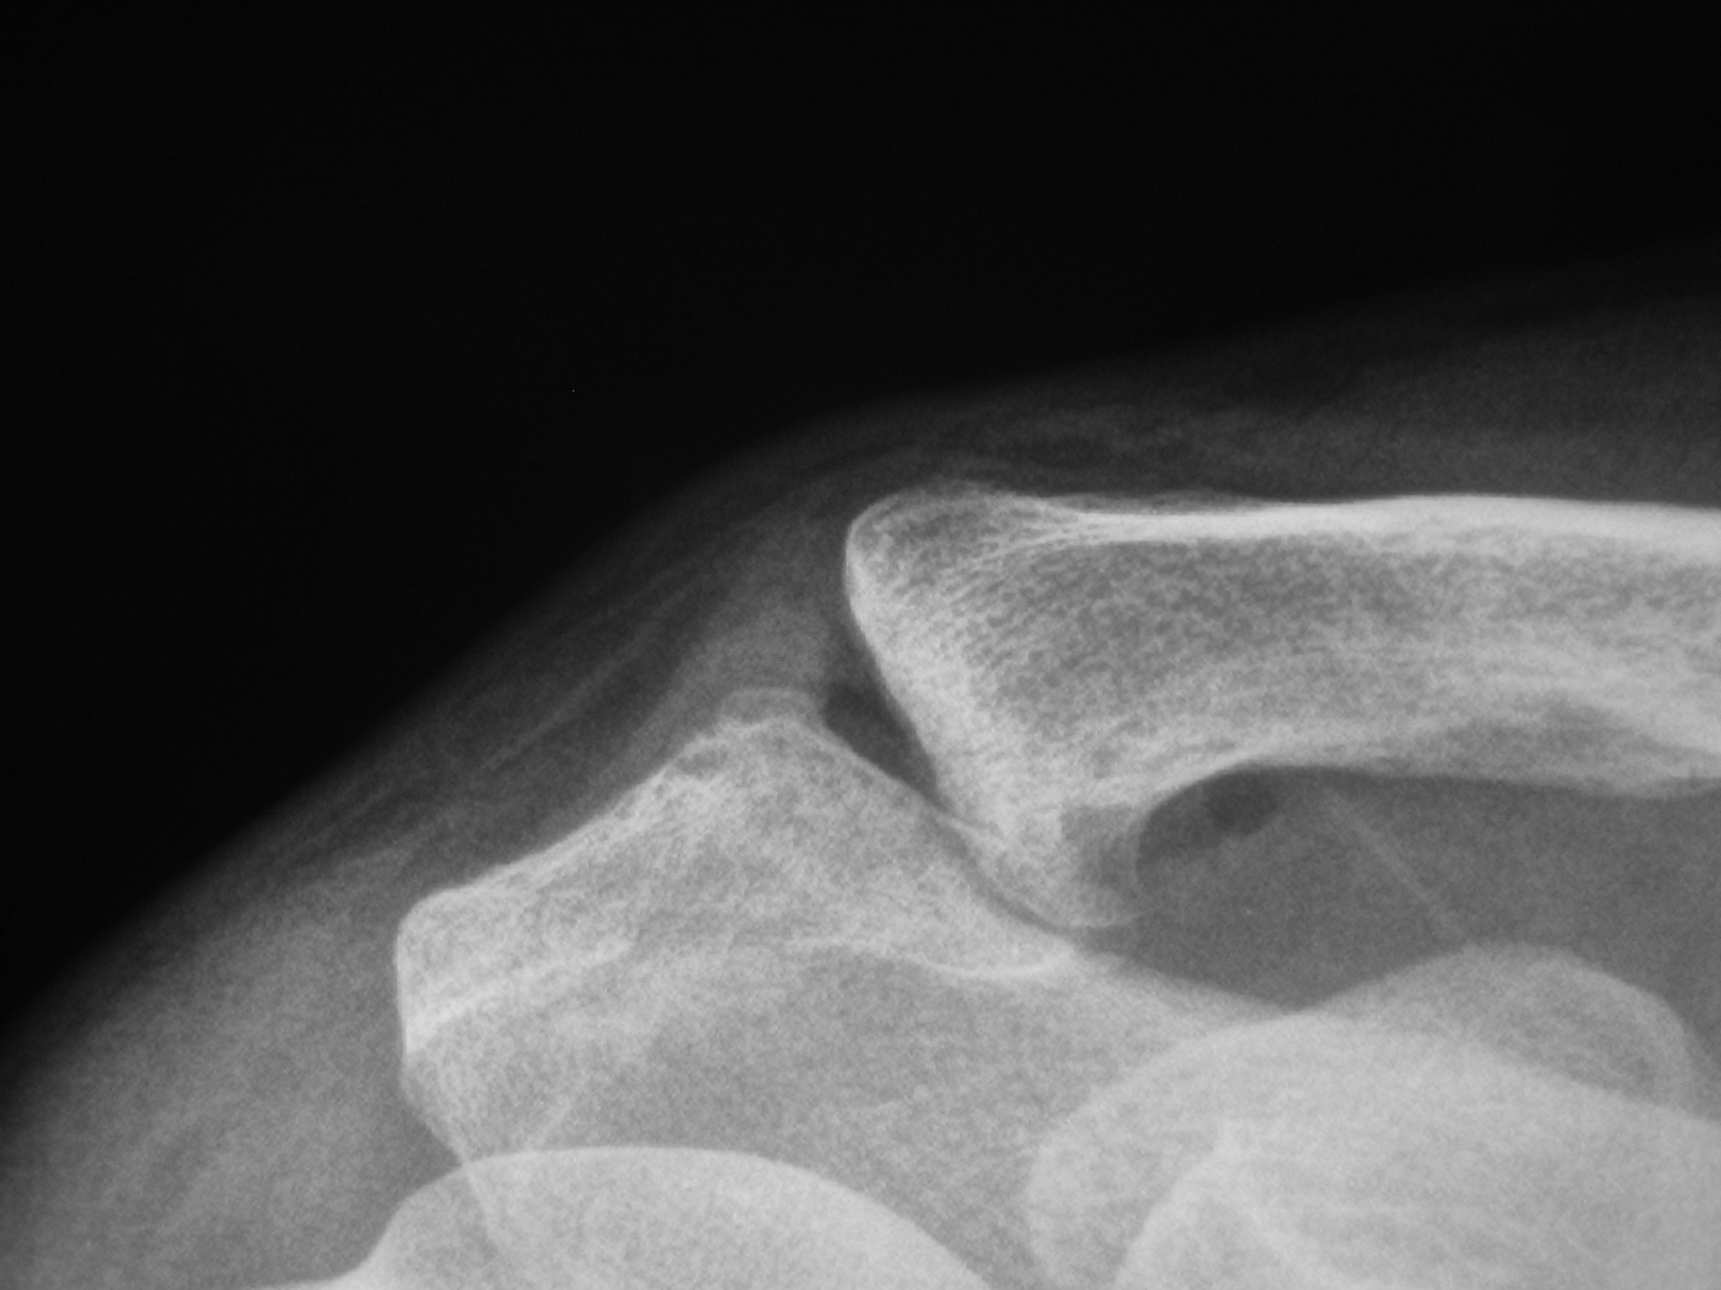

Slide 101
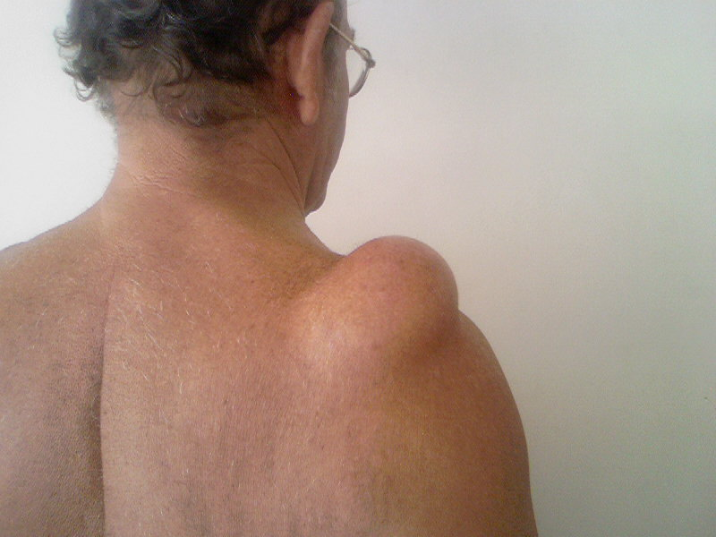

Slide 102
Acromioclavicular Joint Signs
Tender
Pull apart test
Extension test

Slide 103
Acromioclavicular Joint Treatment
Symptomatic treatment
Arthroscopic excision of distal clavicle if symptomatic treatment fails

Slide 105
Calcium in the Shoulder
What do you really need to know?
Well, not much really.

Slide 106
Calcium in the Shoulder
Embedded in the rotator cuff
Common
Young and middle aged adults
Unknown cause
Often disappears
Often asymptomatic

Slide 107
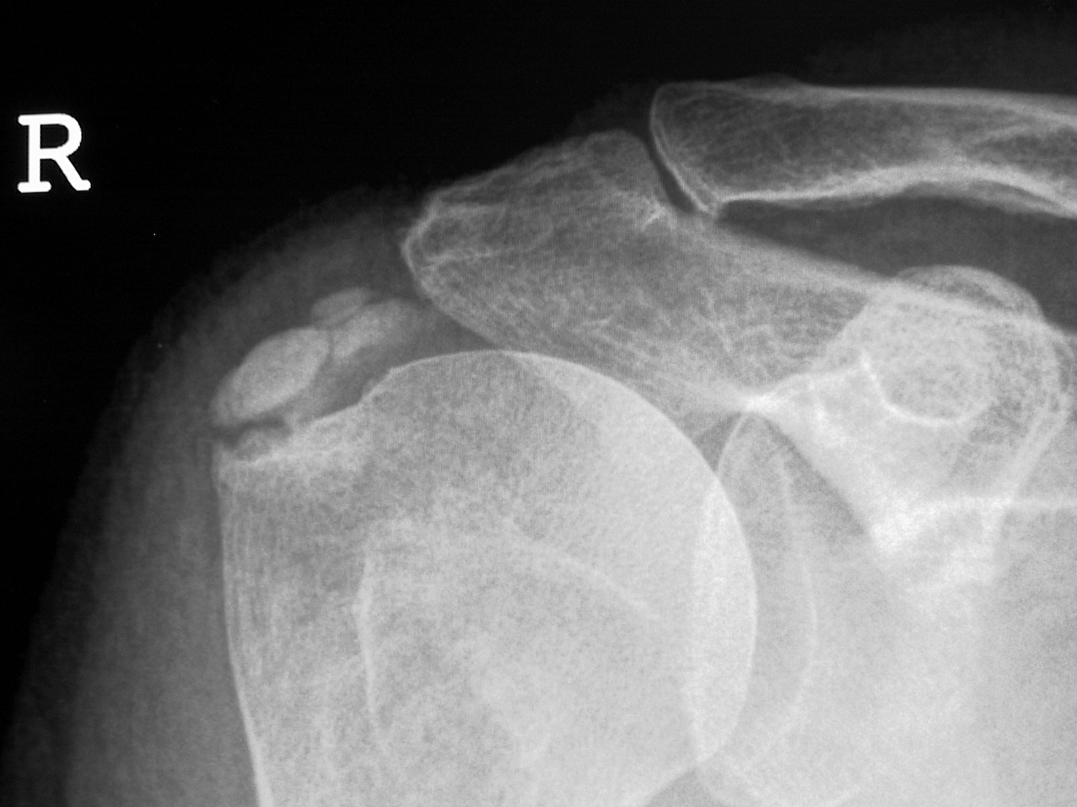

Slide 108
Just consider calcium a possible cause of bursitis

Slide 109
Calcium causes –
No symptoms
- ignore
Chronic bursitis
- treat exactly as for bursitis without calcium
Acute bursitis
- “acute calcific tendonitis”

Slide 110
Acute Calcific Tendonitis
Body mounts a sudden unprovoked merciless attack on the innocent calcium!!!!
Marked inflammation with severe pain

Slide 111
Acute Calcific Tendonitis
“was fine last night but woke this morning in agony!”
“I thought I was having a heart attack”
“I nearly called the ambulance”
“I can’t move my shoulder at all”

Slide 112
Acute Calcific Tendonitis
Diagnosis
- typical history
- marked pain, tenderness, can’t move
- (exclude trauma and infection)
- X-rays – especially AP in neutral, internal,
and external rotation

Slide 113
Acute Calcific Tendonitis
Treatment
- analgesia eg. NSAID
- subacromial injection
- rarely urgent surgery as it generally
resolves in a week
- surgery to treat recurrent attacks

Slide 114
Chronic bursitis from calcium
Basically ignore the calcium and concentrate on the bursitis.
Ignore calcium seen on ultrasound and not on x-ray – it will be insignificant
If you never discover the calcium it doesn’t matter!

Slide 115
Calcium in the Shoulder
Treatment
- non- operative treatment for 3 months
- refer for surgery if symptoms remain
significant

Slide 116
Subacromial Injection
Principles
- at least 10mls anaesthetic, 1 amp steriod
- 21g needle (NOT smaller)
- start posteriorly
- go in as far as the needle allows
- multiple injections in different spots
- ONLY INJECT WHEN MINIMAL
RESISTANCE NOTED

Slide 118
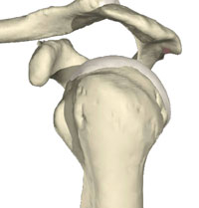
POSTERIOR

Slide 119
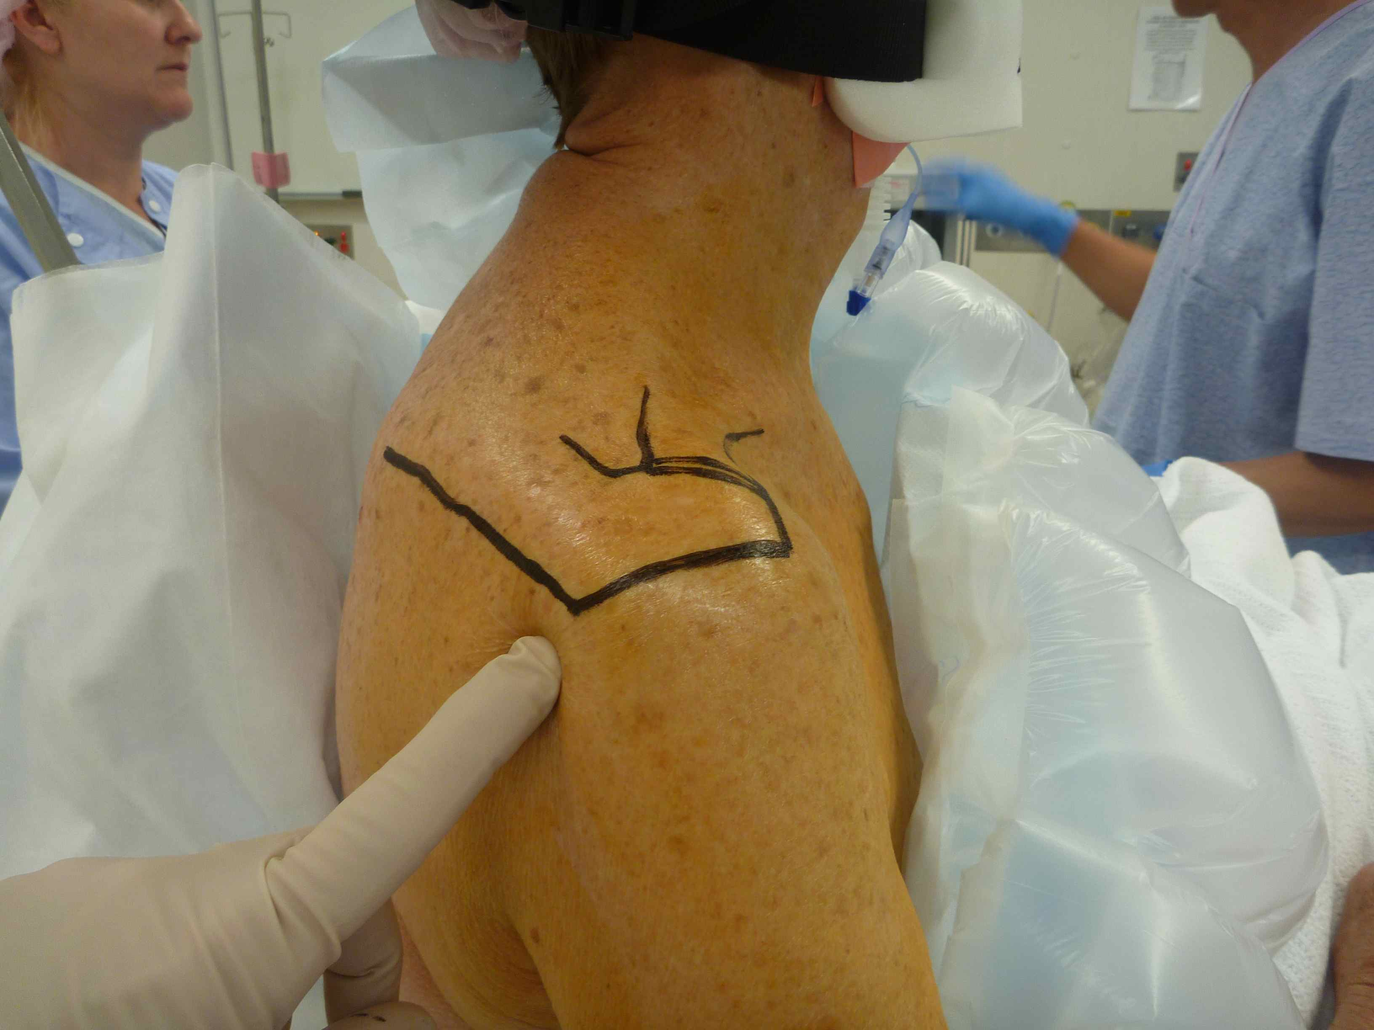
Subacromial Injection

Slide 120
Instability & Labral Tears

Slide 121
Acute Dislocations – Post Reduction Care
Sling until comfortable (approx 3 weeks)
Exclude complications
- rotator cuff tear
- nerve palsy
- fractures

Slide 122
Cuff Tears In Dislocations
VERY IMPORTANT!!!!
Common – 40% at age 65
Disastrous if missed – retracts markedly and quickly and becomes irreparable in just a few weeks with significant long term loss of function

Slide 123
Cuff Tears In Dislocations
Must examine rotator cuff power after
dislocation – no contraindications to
doing this, easy to do
Urgent MRI if weak

Slide 124
‘Terrible Triad’ after dislocations
Dislocation
Cuff tear
Frozen shoulder

Slide 125
Cuff Tears In Dislocations
Needs urgent repair within a few weeks

Slide 126
Nerve Injuries In Dislocations
Most commonly axillary (deltoid weakness
and lateral shoulder numbness)
Rest of brachial plexus
- suprascapular nerve (mimics cuff tear)
- hand problems

Slide 127
Nerve Injuries In Dislocations
-Treatment
MRI if cuff tests are weak (exclude cuff tear)
Document and observe
EMG after 3 weeks if no improvement

Slide 128
Acute Dislocations – Investigations
X-ray to exclude fractures
No other investigations at this stage
unless clinically indicated (eg. with
likely cuff tear)

Slide 129
Acute Dislocations – Return to Sport / Work etc
When feels comfortable and minimal pain – 3 - 6 weeks

Slide 130
Acute Dislocations – Should they have surgery after first dislocation?
Possibly indicated on purely medical grounds but other factors usually mean it is not done
(time needed off work, patient doesn’t want it, cost)

Slide 131
Acute Dislocations – What is the chance of re-dislocation?
Related to age – younger =high dislocation rate
Approximately 75% if younger than 20years

Slide 132
Recurrent Dislocations – What are indications for surgery?
Patient has to want surgery and be prepared for rehabilitation and chance of re-dislocation after surgery

Slide 133
Stabilization Surgery
Rehab
6 weeks in sling – NO DRIVING
4 months off heavy work
6 months off sport
Re-dislocation Rate after surgery
5-10% historically but probably
much less now - 2%

Slide 134
Dislocations – surgery
Arthroscopic reconstruction
Highly successful
Open bone grafting (Latarjet) for -
Large bony lesions (‘bony Bankart’)
Revisions

Slide 135
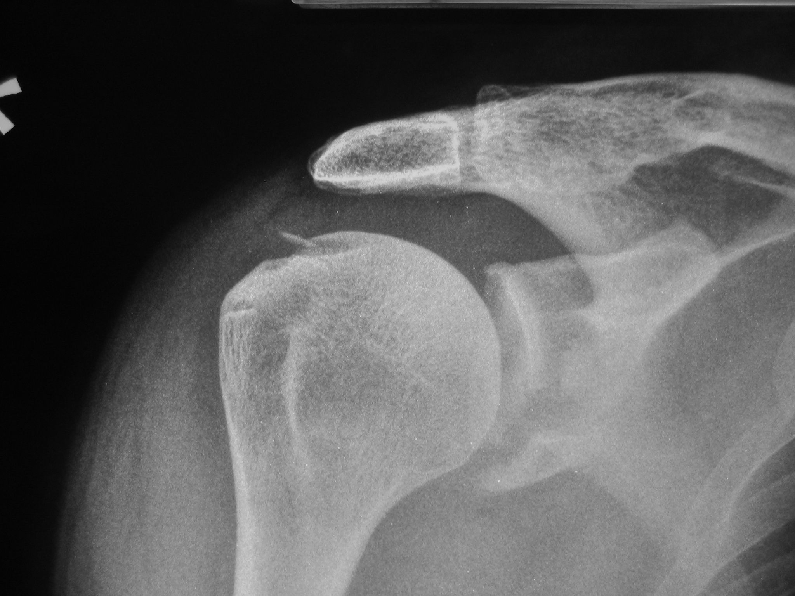

Slide 136
Bony Bankart Lesions
Arthroscopic or open soft tissue procedures FAIL with significant bony Bankart lesions (>20% of glenoid diameter)
Probably the major reason for failures now and in the past

Slide 137
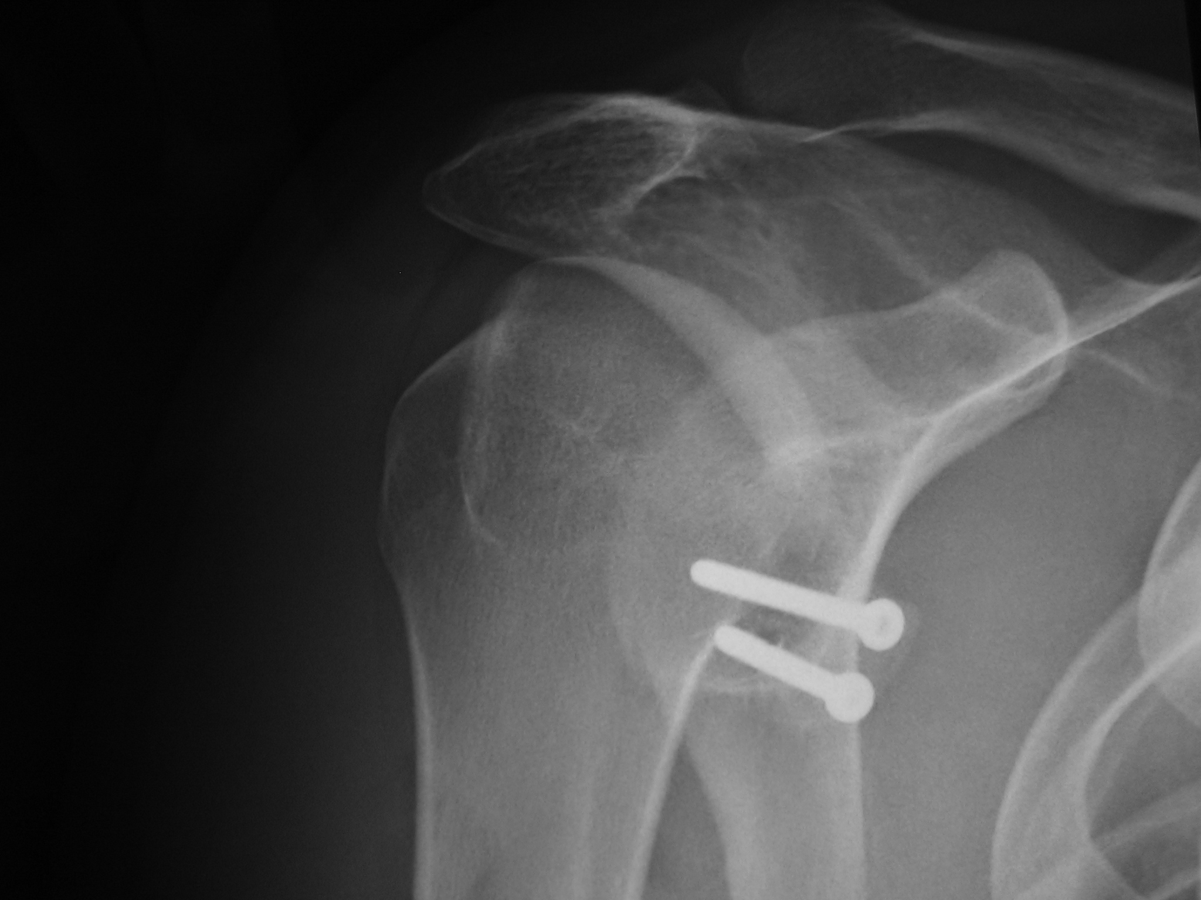

Slide 138
Dislocations – Investigations for referral
Shoulder x-rays
All patients considering stabilization surgery need a CT scan to exclude a bony Bankart lesion

Slide 139
Labral Tears
Result in:-
Subtle instability with secondary bursitis
Pain

Slide 140
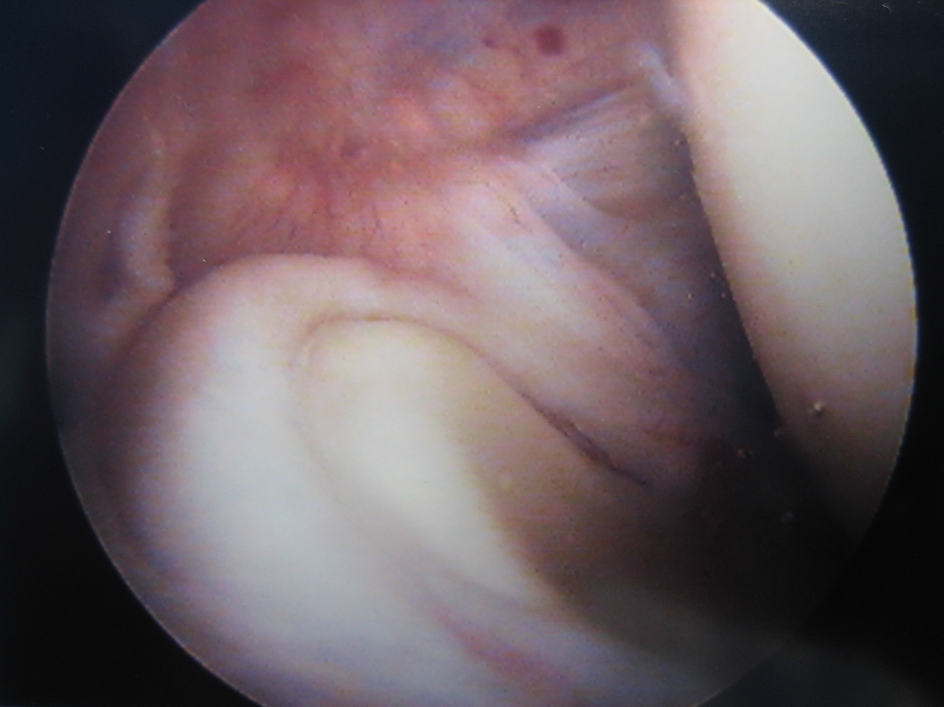

Slide 141
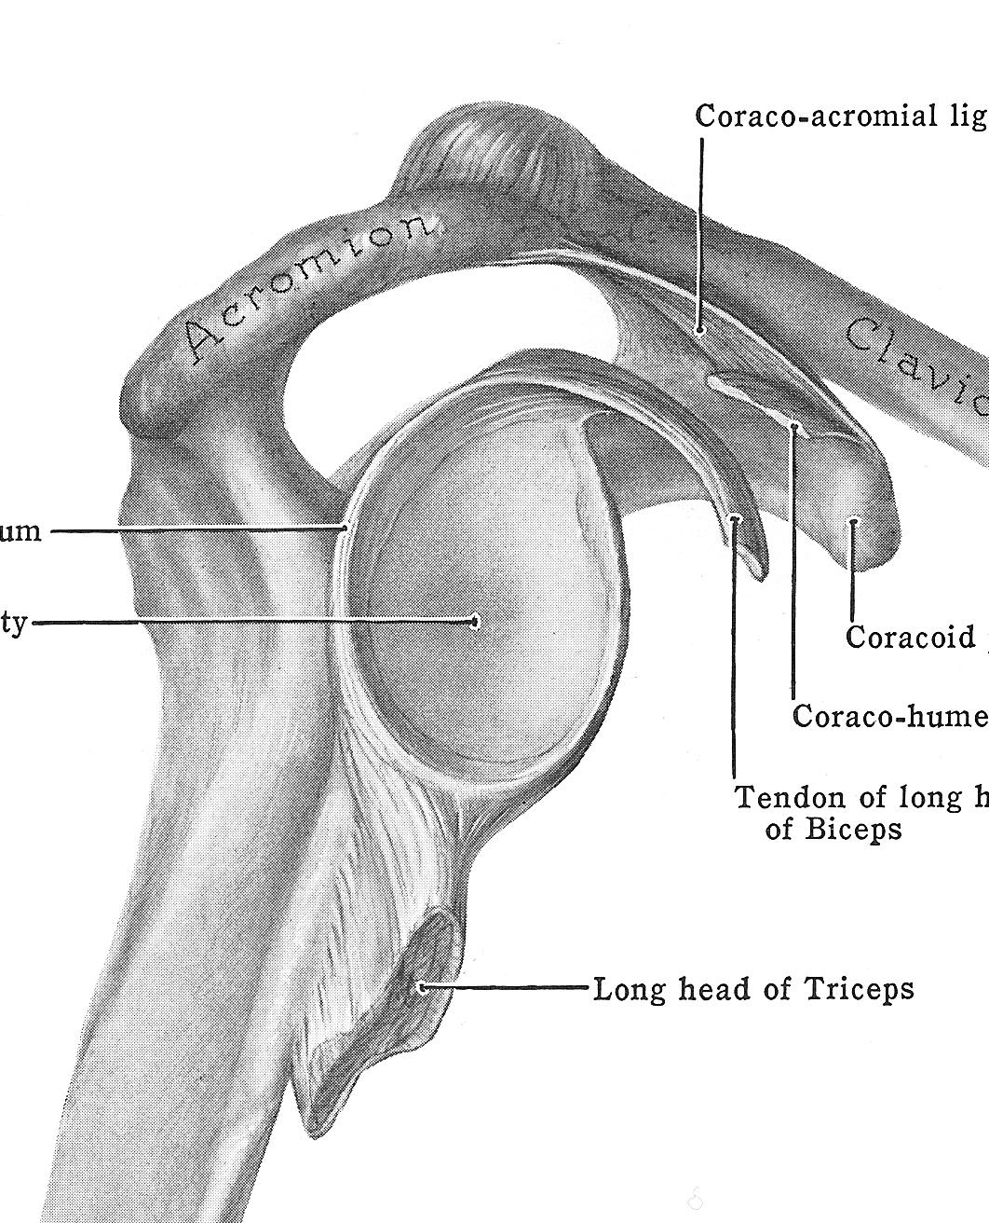
LABRUM

Slide 142
Bankart Lesion

Slide 143
SLAP Tear

Slide 144
SLAP tears
Superior Labrum which goes from Anterior to Posterior

Slide 145
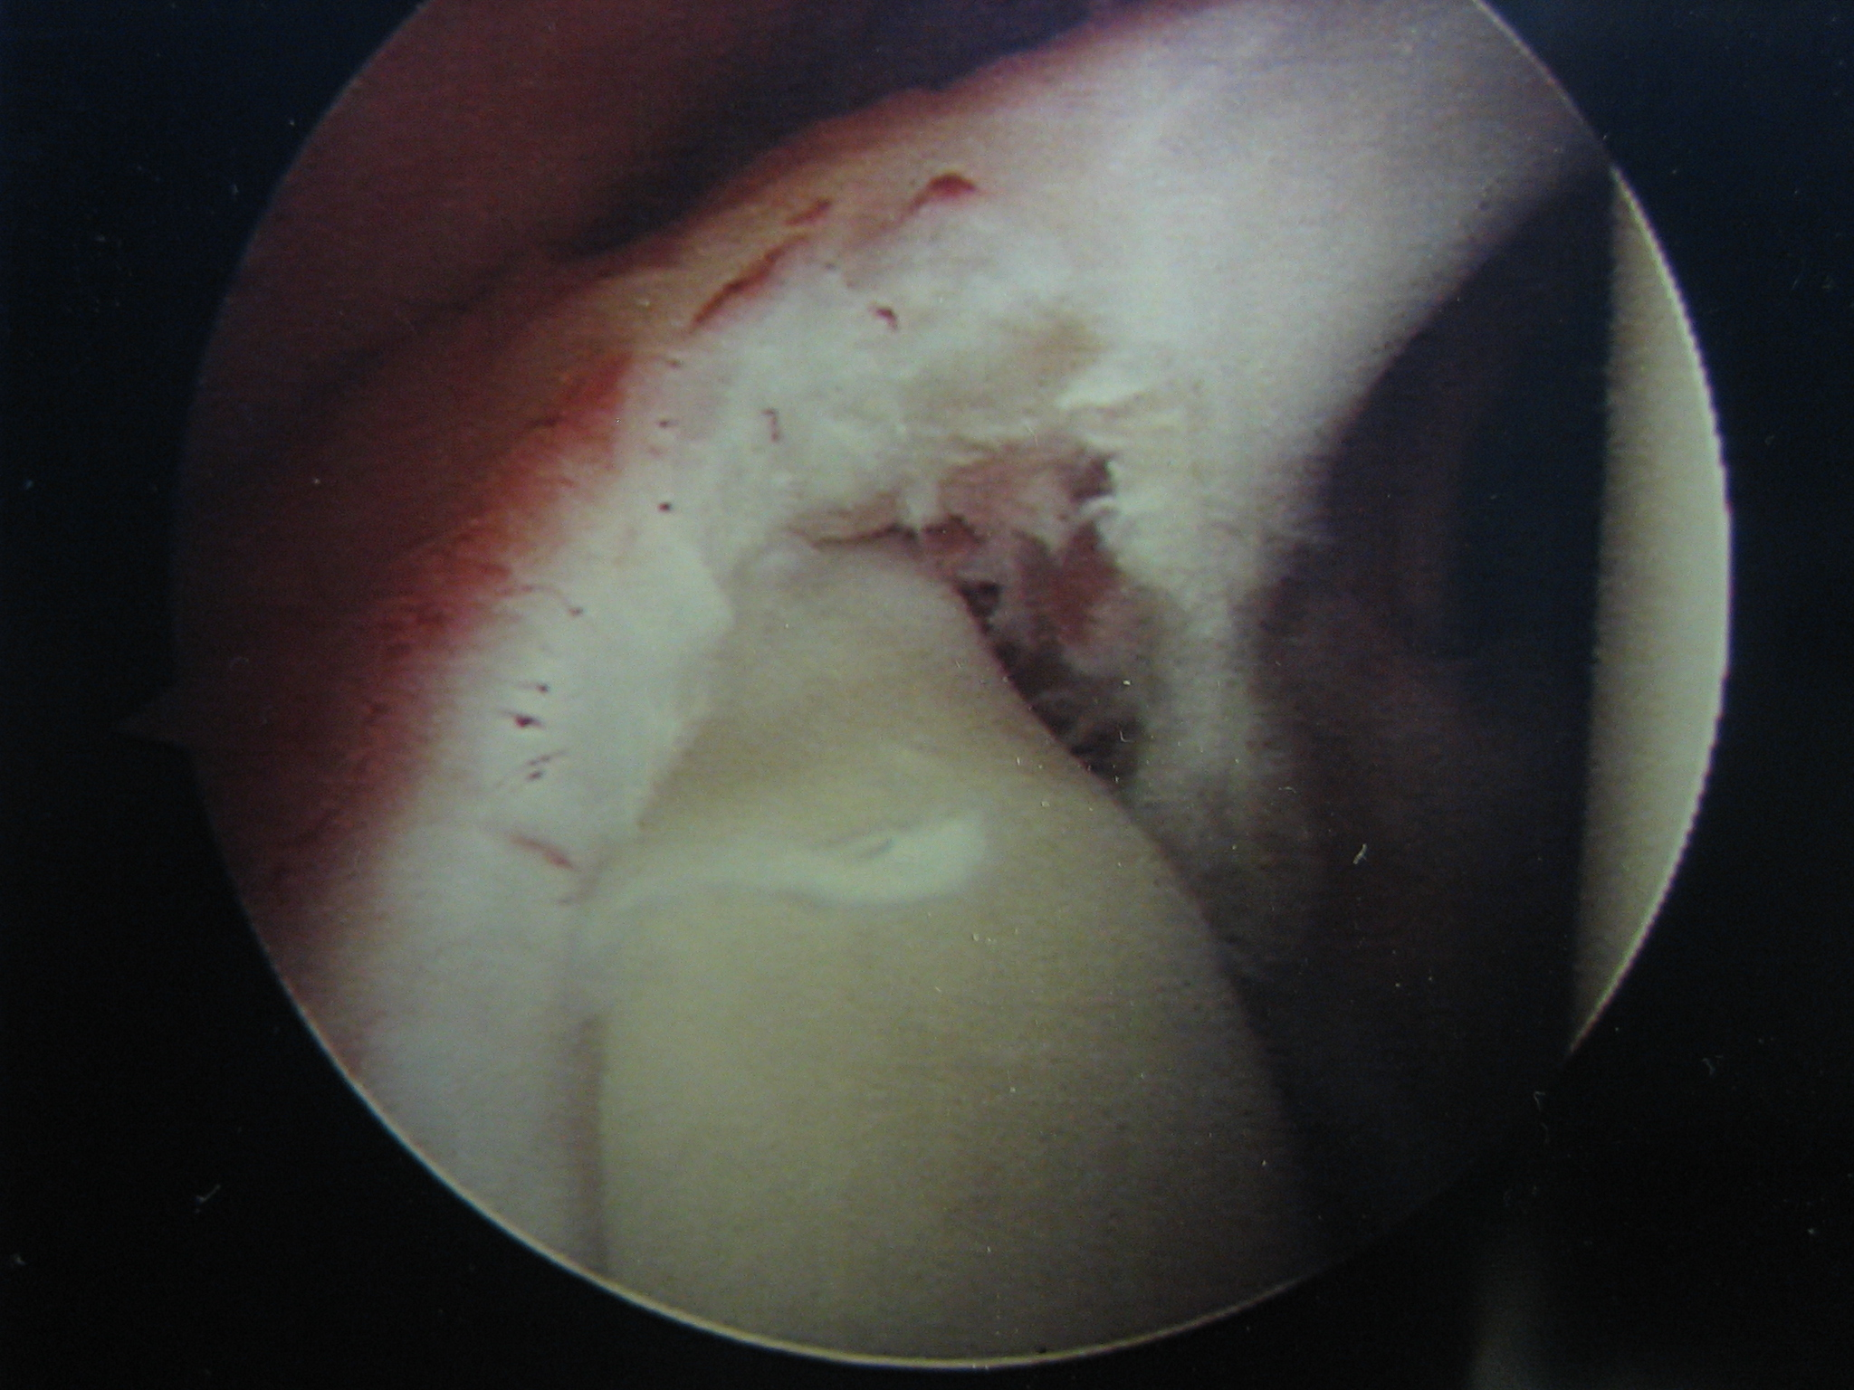
SLAP TEAR

Slide 146
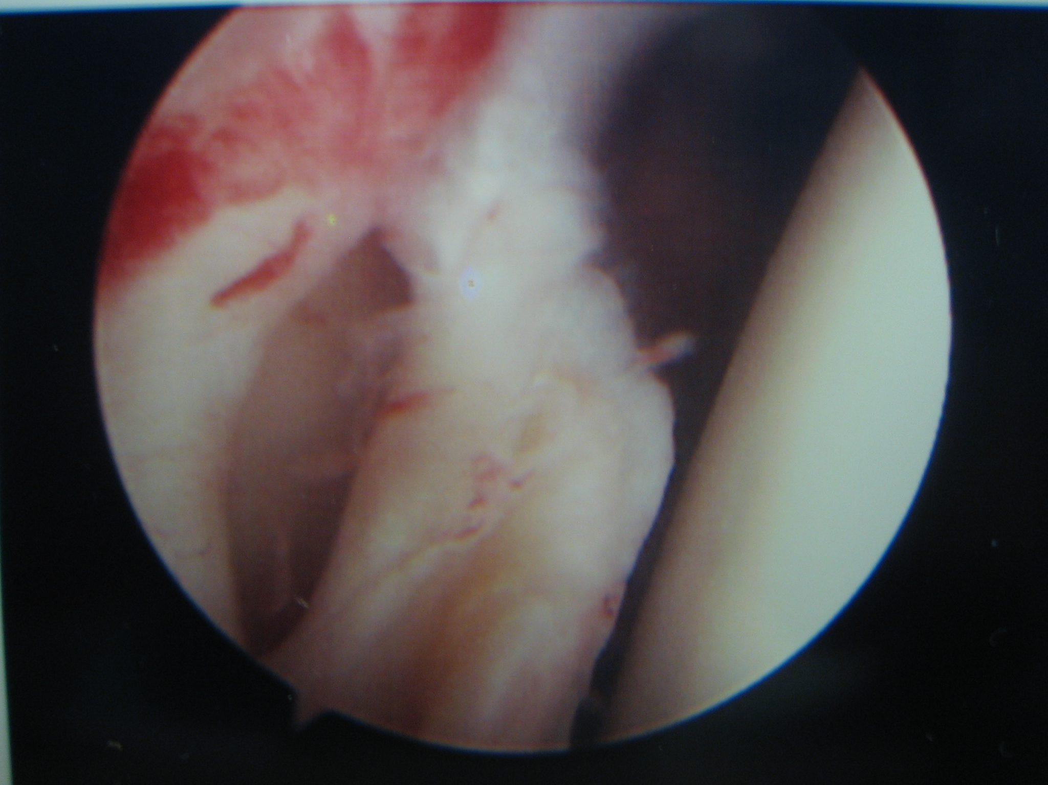
Labral TEAR

Slide 147
Symptoms of labral injuries (subtle instability / SLAP)
Young patients History of definite injury Sharp catching pain Shoulder just “not right”
Aching pain due to secondary bursitis

Slide 148
Signs of labral injuries (subtle instability / SLAP)
Apprehension test

Slide 149
Apprehension Testing
Very good for anterior instability
Patients shoulder placed in abduction and external rotation (‘ABER”)
Reproduces symptoms in that position
Symptoms made better by posteriorly directed force and worse when that force is stopped

Slide 150
Labral Tears (including SLAP tears) - treatment
Arthroscopic repair or debribement

Slide 151
Investigations
X-rays
MR Arthrogram (MRI not good enough)
CT scan for bony Bankart

Slide 152
Multidirectional Instability
Present with recurrent shoulder dislocations or subluxations with minimal trauma
Caused by congenital capsule laxity
Young girls especially
Both shoulders
Don’t do well with surgery!

Slide 153
Posterior Shoulder Dislocations
Uncommon
Very easily missed
Difficult to see on xray
Look for significant pain after trauma
Hallmark is loss of external rotation

Slide 154
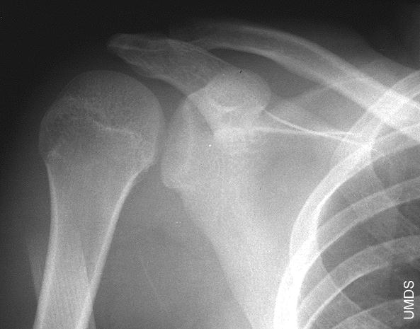
Posterior Shoulder Dislocation

Slide 156
Posterior Shoulder Dislocations
Investigations
X-ray
CT
Refer

Slide 157
Osteoarthritis
Not very common
Often minimal symptoms
Main feature is that when present and symptomatic usually misdiagnosed as cuff tear!

Slide 158
Osteoarthritis - Clinical
Presents like osteoarthritis elsewhere
Pain – aching, worse with use
Stiffness

Slide 159
Osteoarthritis - Diagnosis
Stiffness in older patient
X-ray
- look for loss of joint space,
and humeral osteophytes

Slide 161
Osteoarthritis - Treatment
Similar to osteoarthritis elsewhere
Analgesics including glucosamine
NSAID, and paracetamol
Activity modification
Try physio

Slide 162
Osteoarthritis - Surgery
Arthroscopic debridement
- variable results
- used in younger patients
Joint replacement

Slide 164
Osteoarthritis – When to Refer
When ready for joint replacement!

Slide 165
Shoulder Examination
Range of PASSIVE motion
Bursitis
Rotator cuff strength
Acromioclavicular joint
Instability / Labral tears

Slide 166
Shoulder Examination
Range of PASSIVE motion
Glenohumeral abduction
External rotation
Internal rotation

Slide 167
Passive Range of Motion – Glenohumeral Abduction

Slide 168
Passive Range of Motion – External Rotation

Slide 169
Range of Motion – Internal Rotation

Slide 170
Shoulder Examination
Bursitis
Greater tuberosity tenderness
Impingement sign

Slide 171
Bursitis – Greater Tuberosity Tenderness

Slide 172
Bursitis – Impingement Sign

Slide 173
Shoulder Examination
Rotator cuff strength
Supraspinatus
Abduction
Infraspinatus
External rotation
Subscapularis
Internal rotation

Slide 174
Rotator Cuff Strength – Supraspinatus
Test – Abduction Power

Slide 175
Rotator Cuff Strength – Infraspinatus
Test - External Rotation Power

Slide 176
Rotator Cuff Strength – Subscapularis
Test - Internal Rotation Power

Slide 177
Shoulder Examination
Acromioclaicular joint
Tenderness
Pull apart test
Extension test

Slide 178
AC Joint - Tenderness

Slide 179
AC Joint – Pull Apart Test

Slide 180
AC Joint – Extension Test

Slide 181
Instability / Labral tears
Anterior instability
Abduction and external rotation
- apprehension
- relocation
- release

Slide 182
Anterior Instability - Apprehension Test

Slide 183
Anterior Instability – Relocation Test

Slide 184
30 Second Shoulder Examination
Active elevation above head
Range of external rotation (both sides)
Impingement sign
Supraspinatus power
ACJ tenderness
Apprehension in abduction & external
rotation (ideally lying down)

Slide 186
Bursitis – Impingement Sign

Slide 187
Rotator Cuff Strength – Supraspinatus
Test – Abduction Power

Slide 188
AC Joint - Tenderness

Slide 189
Anterior Instability - Apprehension Test

Slide 190
Loss of Active Elevation
Passive OK?
No
Yes
X-ray shows OA?
Yes
No
Large Cuff Tear
OA
Frozen shoulder

Slide 191
Diagnoses Not to Miss
Large rotator cuff tears after trauma
Posterior dislocations
Displaced greater tuberosity fractures
Distal clavicle fractures
Frozen shoulder

Slide 192
Diagnosis Related to Age
First Third of Life
Overuse problems
Instability
ACJ problems (osteolysis)
Calcific tendonopathy

Slide 193
Diagnosis Related to Age
Second Third of Life
Overuse problems
Chronic Bursitis ➔ Small cuff tears
Frozen shoulder
Calcific tendonopathy

Slide 194
Diagnosis Related to Age
Last Third of Life
Small cuff tears ➔ Large cuff tears
Osteoarthritis

Slide 195
General Rehabilitation and Return to work plan
Ask :- Was something repaired?
NO
- arthroscopic subacromial decompression
- ACJ excision
- frozen shoulder release
YES
- rotator cuff repair
- stabilization
- joint replacement

Slide 196
No repair
- sling for comfort, allow full use
- resume normal activities when able
- don’t overdo it!
- off one month, desk duties one
month, light duties one month
(‘1,1,1 rule’)

Slide 197
Repair
Sling on for 6 weeks - can’t use shoulder at all
Allow hand, wrist and elbow movement
After 6 weeks come out of the sling and can use for gentle day to day activities
Off work two months, desk duties one month, light duties below shoulder one month, light duties above shoulder one month (‘2,1,1,1 rule’)

Slide 198
IF Repair Has Been Done and Needs 6 Weeks in Sling
May use hand in sling
May lean forward and passively swing arm away from body to wash under axilla and allow some air flow to axilla
Should keep strap around waist in bed at night
Can take waist strap off when awake

Slide 199
IF Repair Has Been Done and Needs 6 Weeks in Sling
Occasionally straighten out elbow to prevent ulna nerve compression
Go very slowly – stiffness will get better, re-tears will not!

Slide 200
Complications
Bruising
- very common – ignore!
Stiffness
- very common – ignore!
Infection
- very uncommon, refer
- no antibiotics if serious infection
Rashes
- gently passively abduct arm away from
body just enough to allow air to axilla

Slide 201
Complications of Surgery
Numb little finger
- due to ulna nerve compression with
elbow flexed
- treat by allowing arm passively out of
sling and straighten out elbow
Nausea
- stop drugs
Pain
- look for complications
- give adequate analgesia

Slide 202
Workers Compensation
Work has to be a “significant contributing factor”

Slide 203
What is covered by Workers Compensation?
1/ Definite sudden trauma with significant force
2/ Heavy manual work
3/ Repetitive work against some resistance

Slide 204
What is covered by Workers Compensation?
Injury may have cause “post traumatic bursitis” – sub-acromial bursitis secondary to trauma

Slide 205
Management of Workers Compensation Cases
1/ Correct diagnosis and treatment
Often initial non-operative treatment
May or may not need surgery

Slide 206
Management of Workers Compensation Cases
2/ Set endpoint for the effects of the work injury
Often 4-6 months (More if frozen shoulder)
At the end of this period declare the
condition “stable and stationary”

Slide 207
Management of Workers Compensation Cases
3/ When stable and stationary have patient assessed for any permanent impairment

Slide 208
Workers Compensation
– What do I tell patients with pre-existing
asymptomatic problems?
“Your shoulder problem is due to age related degenerative changes
Stirred up by
Your work / Your injury at work”

Slide 209
Workers Compensation
– What do I tell patients with pre-existing
asymptomatic problems?
“I can fix the problems in your shoulder related to your work
BUT
You may be left with some aches and pains due to the normal aging process and workers compensation may or may not cover these”

Slide 210
Workers Compensation
– What do I tell patients with pre-existing
asymptomatic problems?
I point out that not all people are suited to all jobs, particularly as they get older
They may need to consider a change of job

Slide 211
Workers Compensation
– What do I tell patients with pre-existing
asymptomatic problems?
If they are not prepared to accept this then I will not offer them surgery

Slide 212
Referral - Investigations
All patients need plain shoulder xrays
- ‘? Rotator cuff tear’
- ACJ need separate request
Recurrent dislocations
- CT scan ‘fine cuts of glenoid’
Others
- ideally MR Arthrogram
- ultrasound best – needed if no MRI

Slide 213
Case 1
22 year old recurrent dislocations, dislocation 2 days ago
Exam
- examine rotator cuff – 3 muscles
- examine nerves especially axillary (deltoid)
Investigations
- Shoulder x-ray – confirm enlocated,
exclude fractures
Treatment – sling for comfort

Slide 214
Case 1
22 year old recurrent dislocations, returns 2 months later, wants definitive treatment
History
- excluded mutidirectional (lack of trauma,
both sides affected)
Exam
- ABER test
Refer
- plain x-rays
- CT scan with fine cuts of glenoid

Slide 215
Case 2
45 year old female 3 months of shoulder pain with overhead activities, no trauma
1st Diagnosis to consider
- frozen shoulder

Slide 216
Case 2
45 year old female 3 months of shoulder pain with overhead activities, no trauma
2nd Diagnosis to consider
- frozen shoulder

Slide 217
Case 2
45 year old female 3 months of shoulder pain with overhead activities, no trauma
3rd Diagnosis to consider
- frozen shoulder

Slide 218
Case 2
45 year old female 3 months of shoulder pain with overhead activities, no trauma
Then consider
- subacromial bursitis (+/- calcium)

Slide 219
Case 2
45 year old female 3 months of shoulder pain with overhead activities, no trauma
Examination
- passive range of motion = 30 degrees ER,
60 degrees glenohumeral abduction
X-ray
= normal

Slide 220
Case 2
45 year old female 3 months of shoulder pain with overhead activities, no trauma
Diagnosis – Frozen shoulder
Treatment
- stop stretching
- NSAID
- cortisone injection

Slide 221
Case 3
45 year old female 3 months of shoulder pain with overhead activities, no trauma
Examination
- passive range of motion = full range of motion
- +ve impingement sign, tender greater
tuberosity
X-ray
= normal

Slide 222
Case 3
45 year old female 3 months of shoulder pain with overhead activities, no trauma
Ultrasound – partial, possible full thickness cuff tear
Diagnosis – Bursitis
Treatment
- NSAID, activity modification
- steroid injection
No improvement – refer for surgery, ideally with MRA

Slide 223
Case 4
72 year old male 9 months of shoulder pain with overhead activities
History
- exclude trauma (acute cuff tear)
Examination
- full range of motion but weakness of rotator
cuff, impingement signs positive

Slide 224
Case 4
72 year old male 9 months of shoulder pain with overhead activities, no trauma
Diagnosis
- cuff tear ?repairable
- osteoarthritis
X–ray = no osteoarthritis
Diagnosis = cuff tear
Refer for surgery if symptoms significant
Plan MRA to assess whether cuff is repairable

Slide 225
Case 5
37 year old male 7 months of intermittent sharp shoulder pain with activities, touch football injury
Diagnosis
- ACJ
- labral tear
Examination
- ACJ non-tender, -ve pull apart test
Diagnosis = possible labral tear

Slide 226
Case 5
37 year old male 7 months of intermittent sharp shoulder pain with activities, touch football injury
Investigation
- MRArthrogram
= possible labral tear
Refer for surgery if bad enough to accept 6 weeks in
sling, 6 month off sport

Slide 227
www.terryhammond.com.au
Patient information
- read about most shoulder conditions
- download information booklets on cuff repairs, subacromial decompression, stabilizations and frozen shoulder
- watch surgical videos
- download physio protocols

Slide 229
Weird Things!
Spinoglenoid cyst
- labral tear acts as a one way valve
and a cyst forms near the glenoid margin
- causes pain and weakness and wasting
due to compression of suprascapular nerve
- needs surgery

Slide 230
Spinoglenoid Cyst (ganglion)

Slide 231
Weird Things!
Brachial Neuritis
- temporary (?viral ) interruption of parts of the
brachial plexus
- causes pain and weakness and wasting
of various muscles – therefore looks like cuff
tear
- can causes scapular winging
- usually resolves after months

Slide 232
Weird Things!
Scapulo-thoracic crepitus
- Usually needs no treatment
- if persistent, consider CT to exclude benign
bone tumour under scapular

Slide 233
Weird Things!
Scapular Winging
- usually secondary to joint pathology
- may have nerve lesion (eg. brachial neuritis)
- if persistent, consider CT to exclude benign
bone tumour under scapular

Slide 234
History Taking in Shoulders

Slide 235
History Taking in Shoulders
Exclude other sources
Establish any definite cause
Establish time frame
Specifics of pain may not be that helpful

Slide 236
History Taking in Shoulders
Exclude other sources – NOT shoulder if
Cental neck pain
pain below elbow
numbness or parasthesia

Slide 237
History Taking in Shoulders
Establish cause
Definite specific significant trauma
OR
Definite overuse
OR
Gradual onset with factors that now aggravate the symptoms

Slide 238
History Taking in Shoulders
Establish time frame
Long history of gradually increasing
symptoms
OR
No problems before this episode

Slide 239
General Management Plan for Shoulder Problems
Most shoulder problems need only symptomatic treatment without a specific diagnosis

Slide 240
General Management Plan for Shoulder Problems
Confirm really is shoulder problem
Exclude ‘worrying diagnoses’
Exclude traumatic causes needing specific diagnoses and urgent treatment
Exclude frozen shoulder

Slide 241
General Management Plan for Shoulder Problems
Then
Treat symptomatically for 3 months
Further investigations and referral if has
not resolved

Slide 242
General Management Plan for Shoulder Problems
Confirm really is shoulder problem
History – no central neck pain,
parasthesia, pain below elbow
Look for tenderness in shoulder and
pain on movement – reproduces
symptoms

Slide 243
General Management Plan for Shoulder Problems
Exclude ‘worrying diagnoses’
Septic arthritis
Tumour
- unremitting pain
- x-ray

Slide 244
General Management Plan for Shoulder Problems
Exclude traumatic causes needing specific diagnoses and urgent treatment
- dislocations especially posterior
- fractures – x-ray
- acute cuff tears esp. with dislocations

Slide 245
General Management Plan for Shoulder Problems
Exclude frozen shoulder
- look for loss of passive movement

Slide 246
General Management Plan for Shoulder Problems
Symptomatic treatment
activity modification (may need rest)
Paracetamol, NSAID
Subacromial bursa injection

Slide 247
General Management Plan for Shoulder Problems
Refer if no improvement after 3 months
Needs
plain x-rays
MRA very useful
Ultrasound definitely second best!

Slide 248
General Management Plan for Shoulder Problems
Does everyone need an x-ray?
Very helpful but probably often not
needed in early stages
Clinical decision in each case

